Slide 1

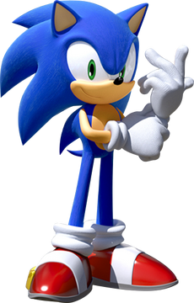
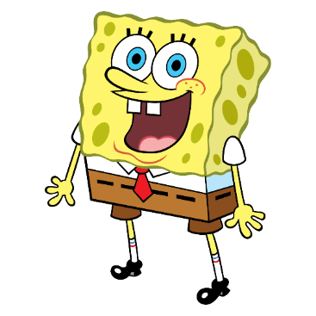


SpongeBob Collaboration
Additional Track Assets / Preset Brush Colours
SEGA

Slide 2
Track Assets

Slide 3
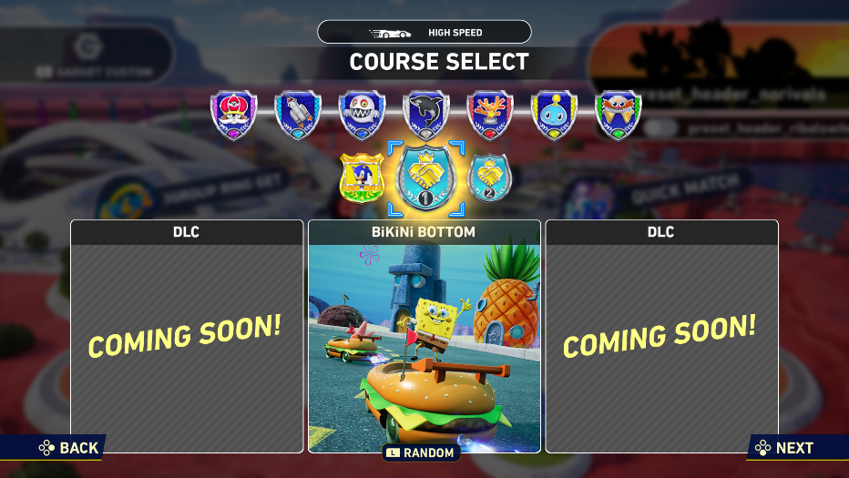
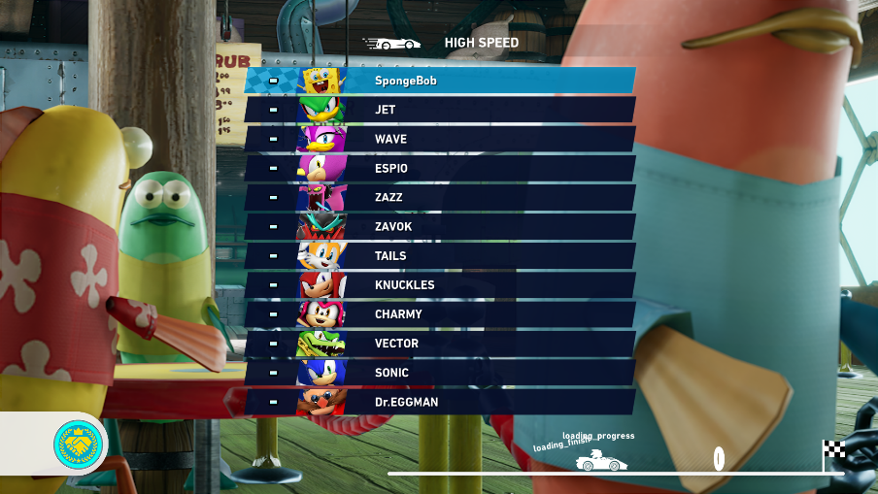
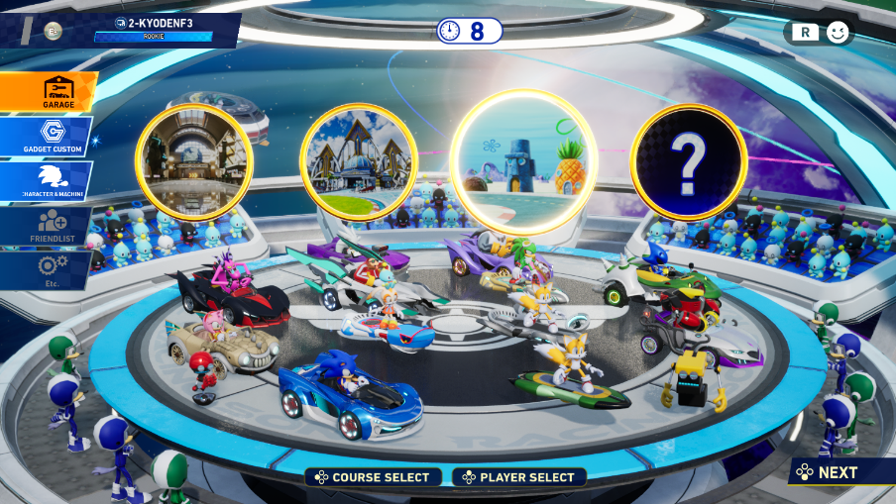
Track Assets
Please review the following images:
- Track icon during offline track selection
- Track background in loading screens
- Track icon during online track selection
Details on each in the following slides.
Track icon (Grand Prix)
Track background (loading)
Track icon (online lobby)

Slide 4
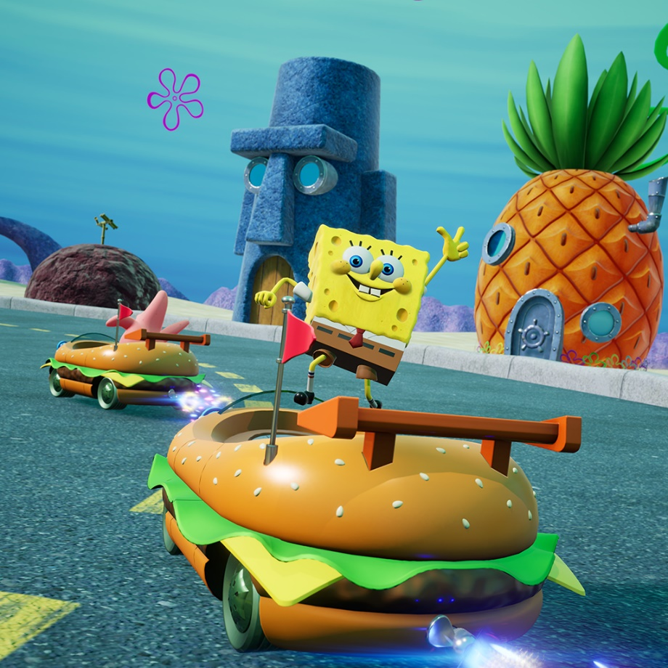

Track Icon (Offline)
Please review the icon for BiKiNi BOTTOM.
When the cursor is placed on the track, music for that track will play –
video for sound review will be sent in separate component.
Source image
In-game capture

Slide 5
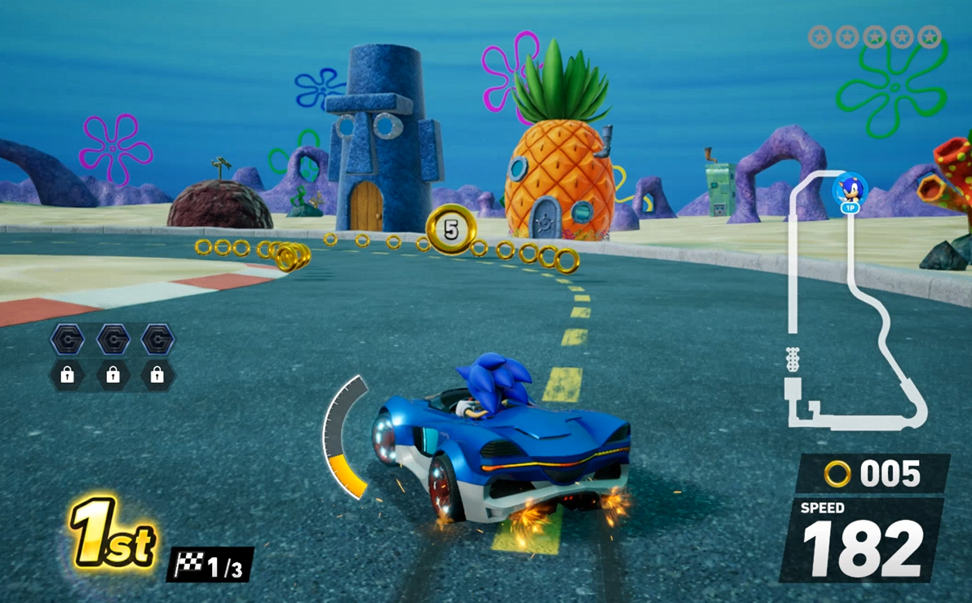
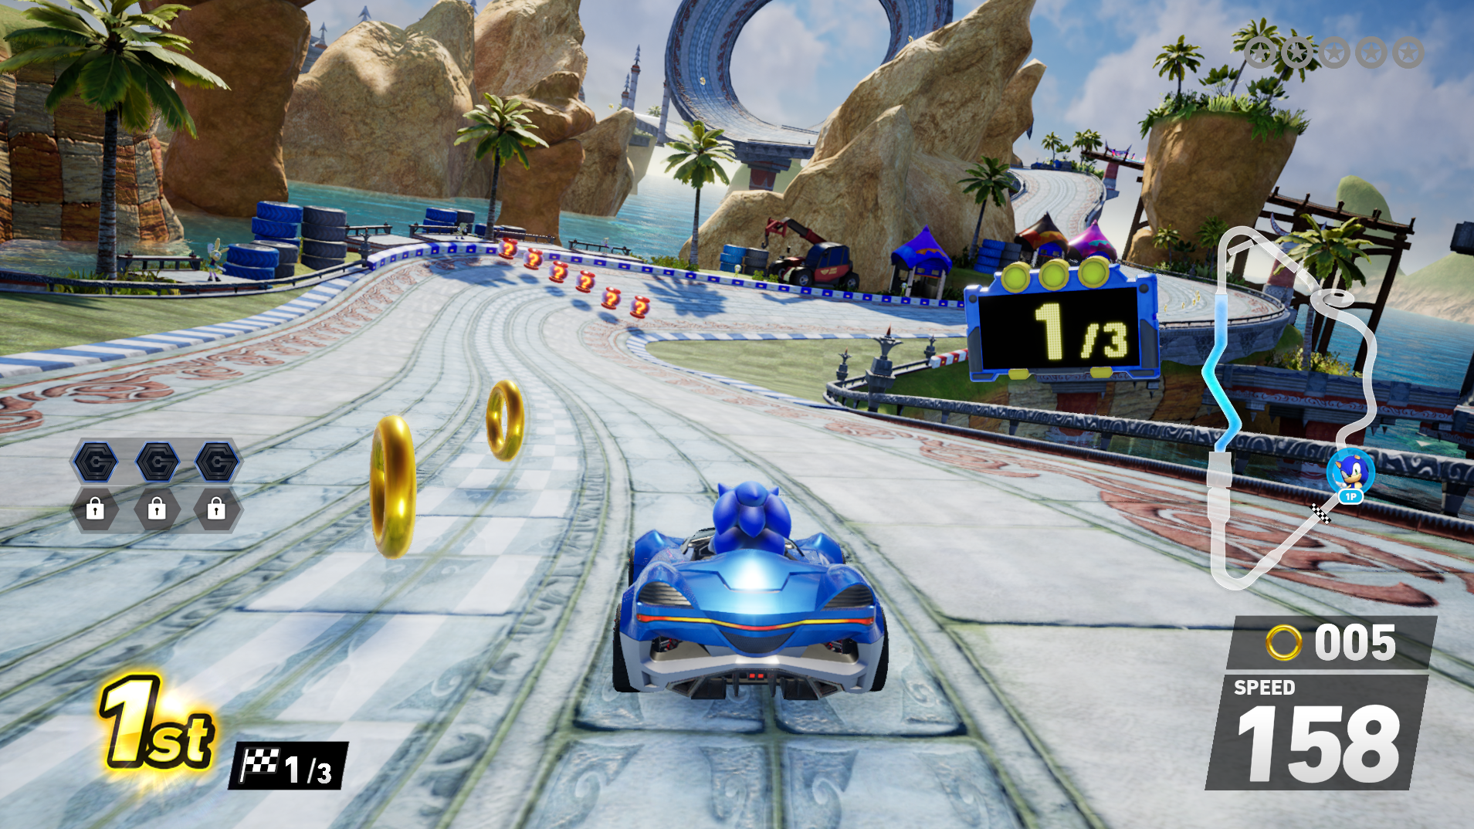
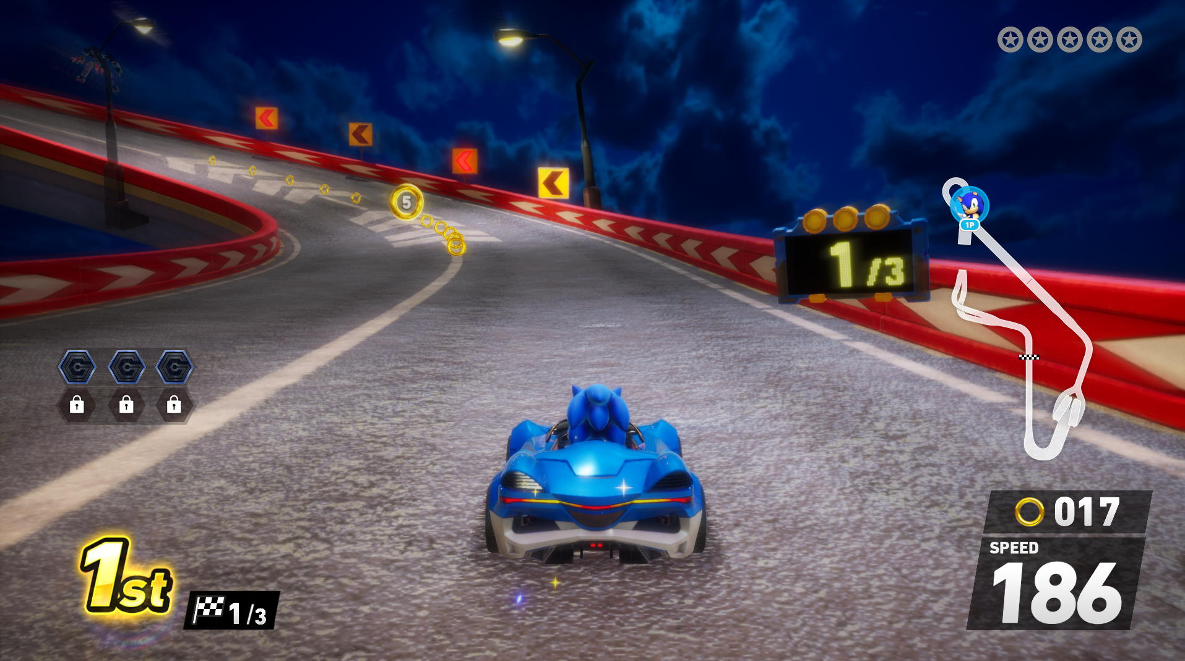

Collaboration Grand Prix
TERRA will have an additional mode where players race 3 collab tracks + 4th track where each lap is from the previous 3 collaboration tracks; ie. BiKiNi BOTTOM + 2 other IPs.
Since collab tracks are paid content, players who haven’t purchased other tracks would race on what tracks are available to them, selected at random. Following order of DLC release, SpongeBob will be the 2nd track.
Collaboration Grand Prix Flow
External Collab Track
External Collab Track
1st race
(3 standard laps)
2nd race
(3 standard laps)
3rd race
(3 standard laps)
Final race
(1 lap each from the previous tracks)
Collaboration Grand Prix will include BiKiNi BOTTOM
and tracks from 2 other companies.
If a user has not purchased the DLC,
tracks will be selected at random from those available.
*Order of the tracks are subject to change during development.

Slide 6
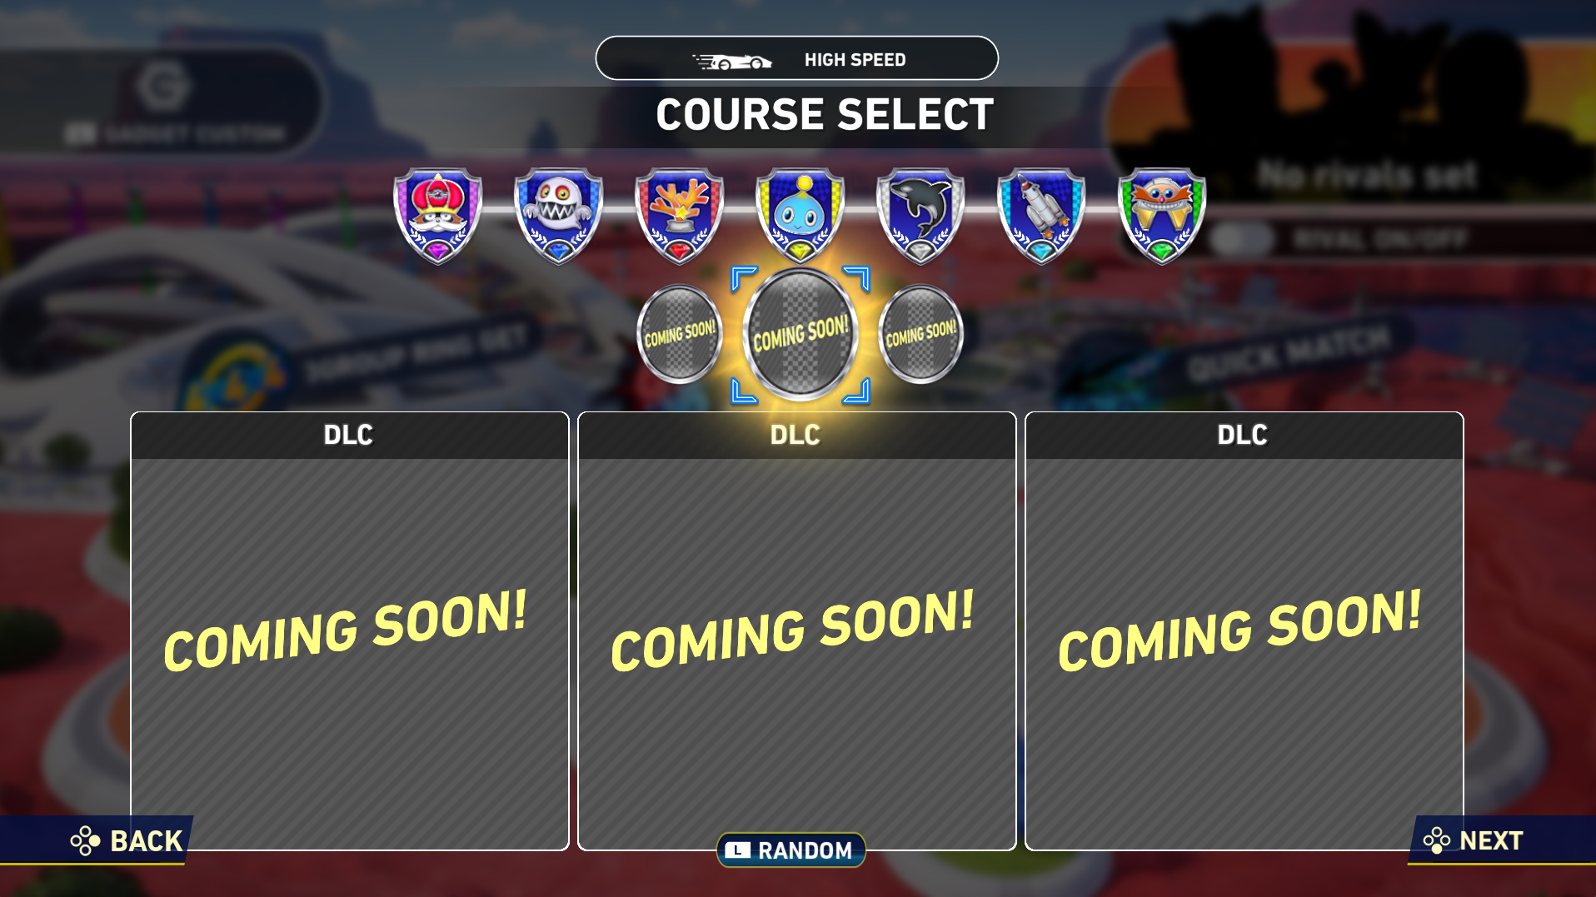
Examples depending on purchases
Purchased:
Collab IP track A
Not purchased:
Random selection from what is available
Not purchased:
Random selection from what is available
Purchased:
Collab IP track A
Purchased:
Collab IP track B
Not purchased:
Random selection from what is available
Purchased:
Collab IP track A
Purchased:
Collab IP track B
Purchased:
Collab IP track C
1 of 3 tracks purchased
2 of 3 tracks purchased
All 3 tracks purchased

Slide 7
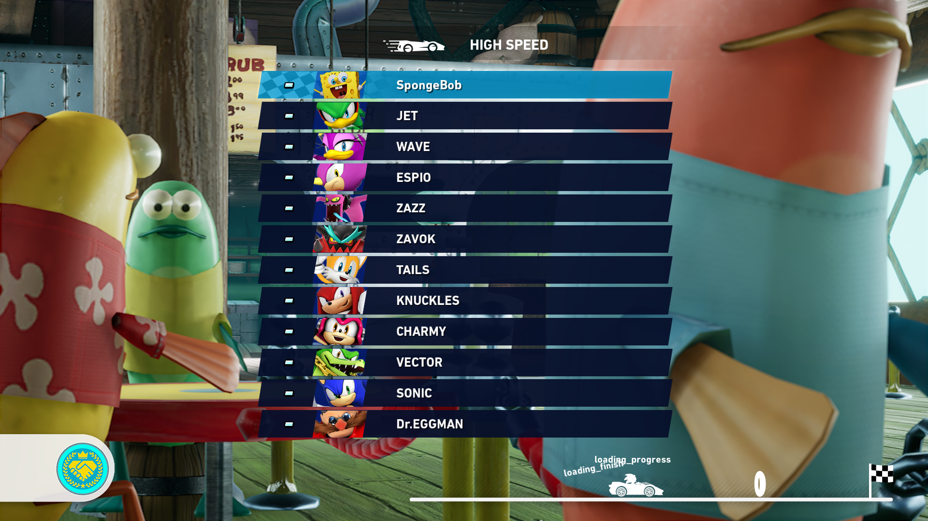
Track Background (Loading Screen)
Please review the asset used below.

Slide 8

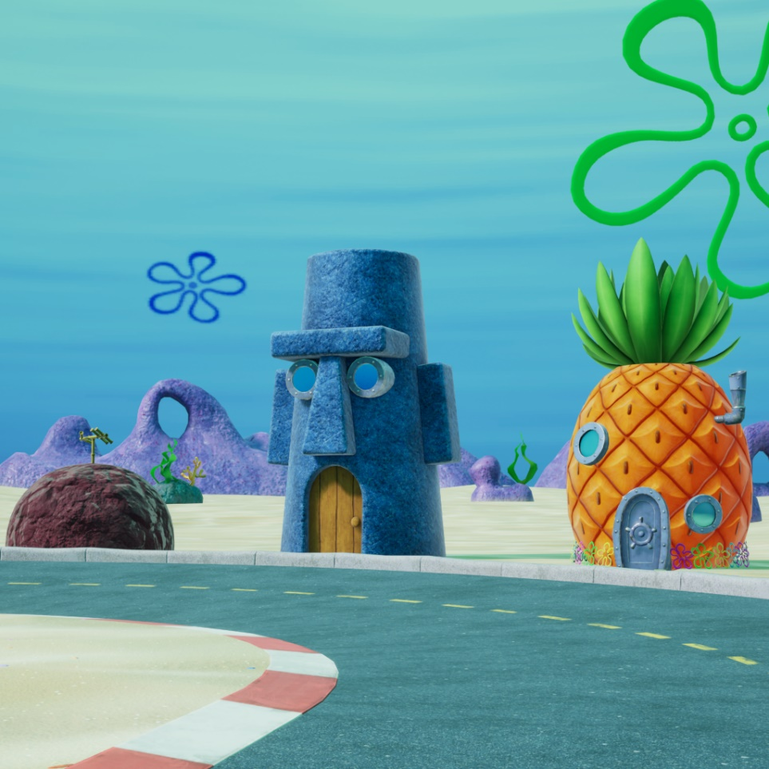
Track Icon (Online)
Please review the icon for BiKiNi BOTTOM in the online lobby.

Slide 9
Preset Colours

Slide 10
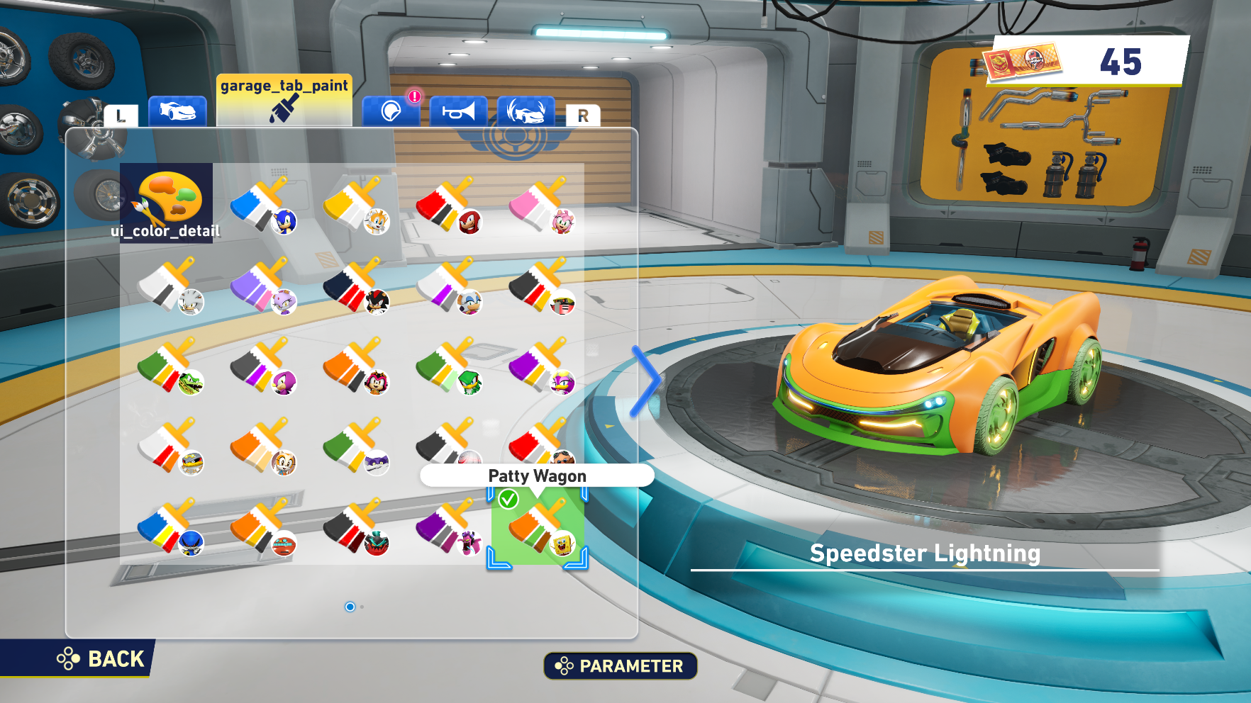
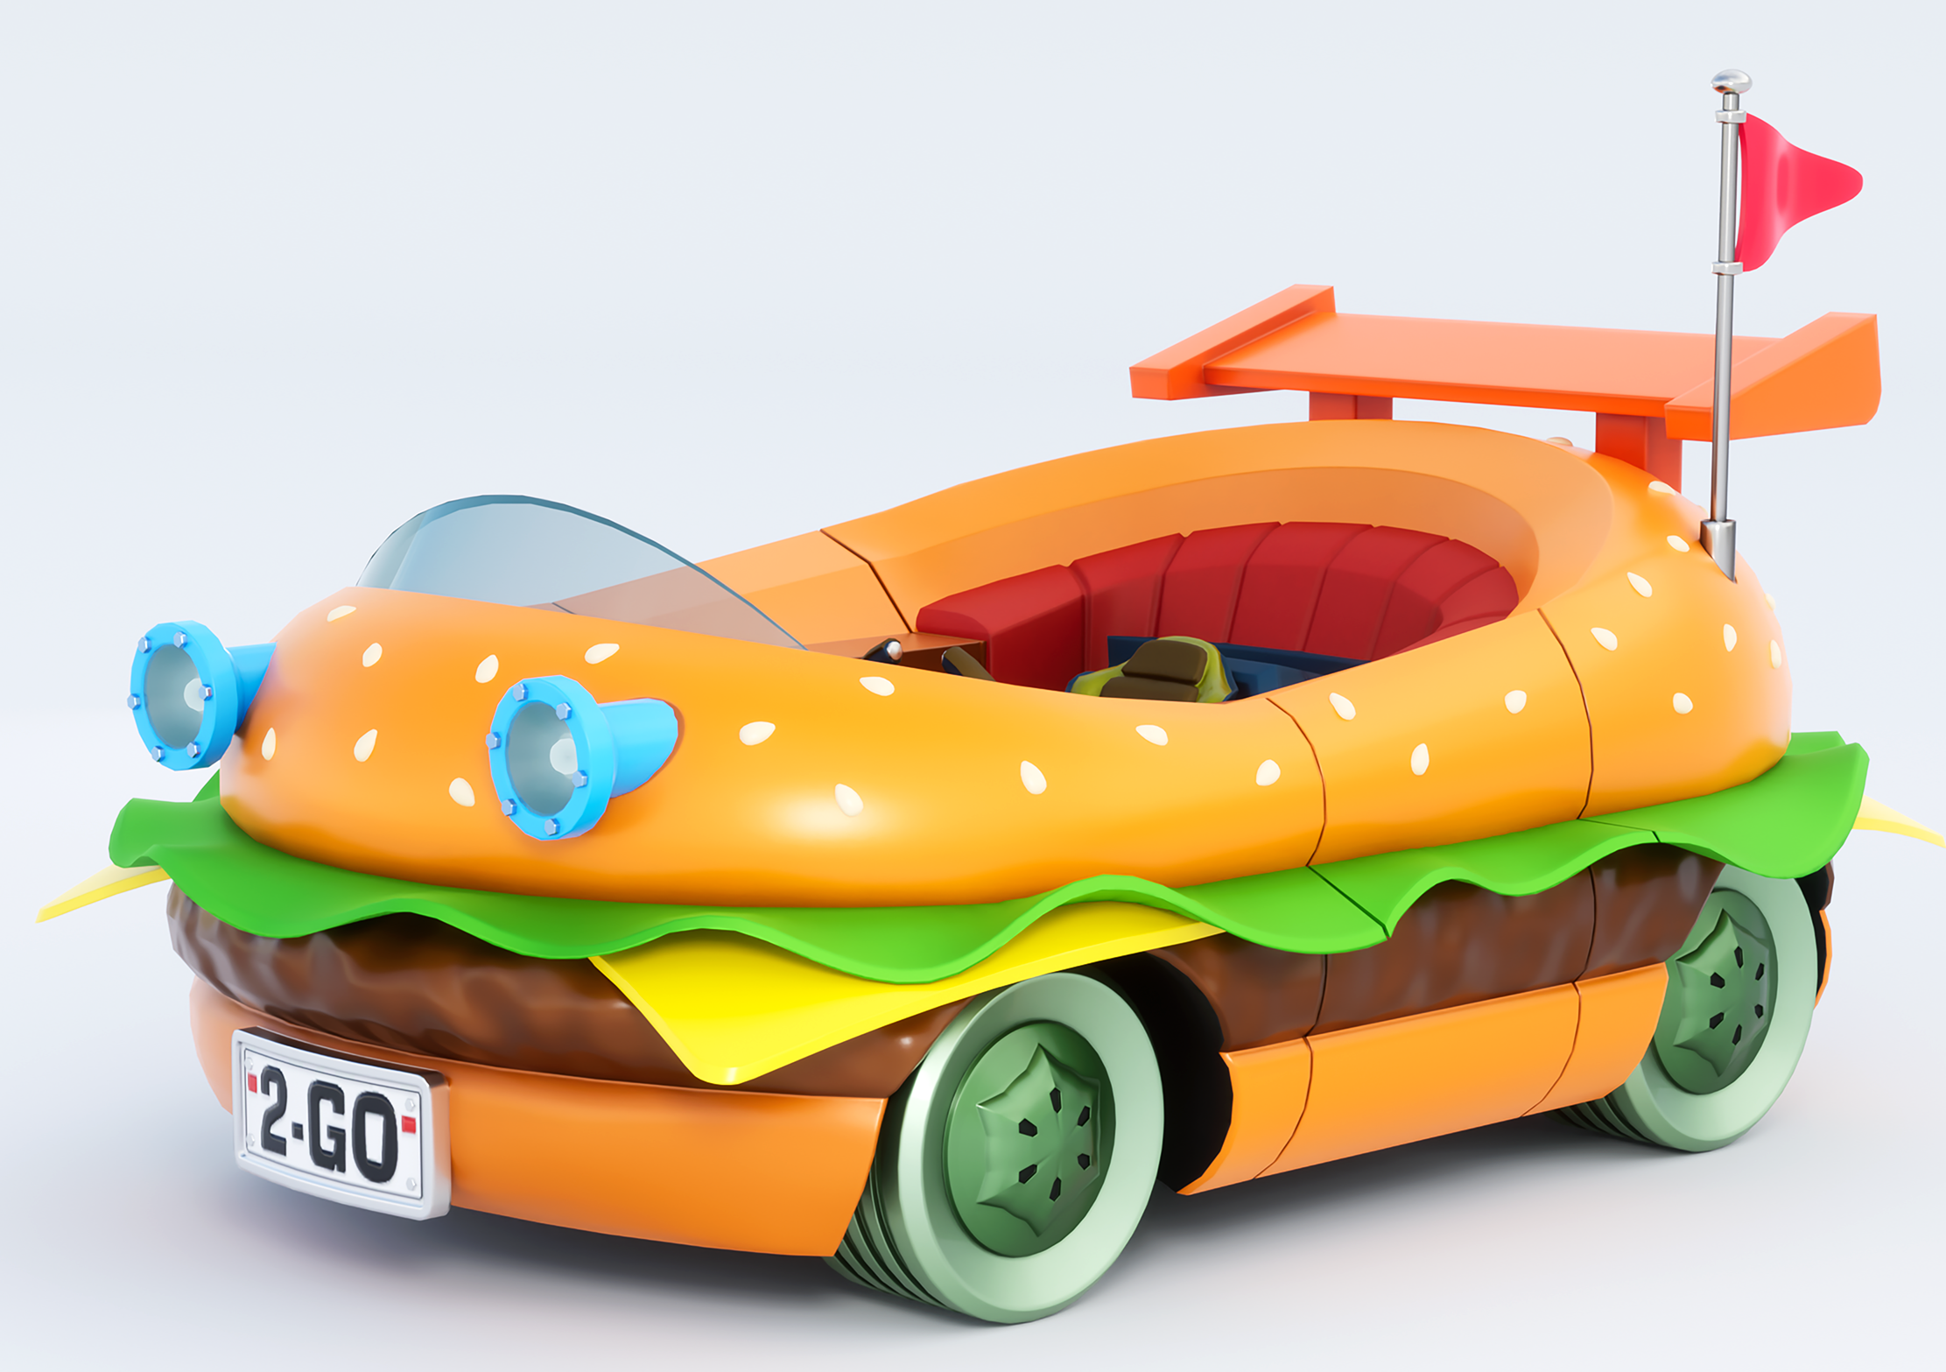

Preset Colours for Patty Wagon
Sonic characters have their own vehicle each, and their colours can be applied to any other vehicle with the press of a button using this preset feature. The default Patty Wagon colours are applied to the brush, and only one character icon can represent the preset – in this case, we have chosen SpongeBob.

Slide 11
Thank you!

