Slide 1





SpongeBob Collaboration
Approval Request: 2D Assets
SEGA

Slide 2







2D Asset List
Thank you for providing visual assets!
Please review in-game assets from below in the following slides.
 | Content | Image | Notes
2D Assets | Reward: Vehicle Decals |  | Players can customise vehicles with stickers
 | Reward: Title Plates |  | Players can set their profile to show off their title
 | Jukebox: Jacket Art |  | Image for the in-game jukebox, which is used like album art
 | Festival: Event Monitor |  | Can be seen on the background monitor in the main menu during limited-time Festival Events
 | Festival: Team Icons |  | Icons for when players team up during Festival Events
 | Festival: End of Event Notice |  | Displays at the end of the Festival Event
 | Reward: Vehicle Decals |  | Players can customise vehicles with stickers
*Other notice/announcement images will be submitted for approval at a later date.

Slide 3
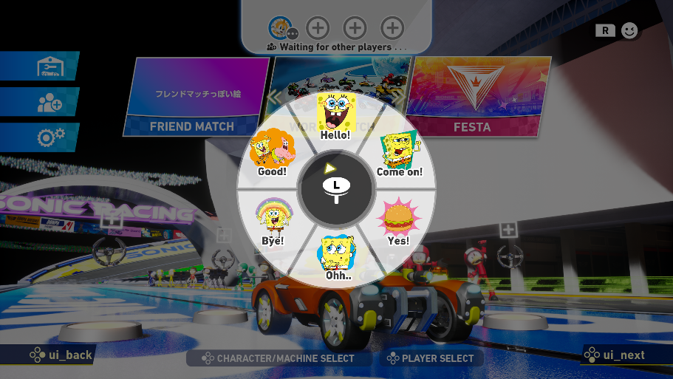












Chat Stamps
These are used in the online lobby for communication between players, and can only be used when driving as SpongeBob or Patrick. The assets include general text like “Yes!” and “Bye” which are common across all stamps.
 |  |  |  | SpongeBob |  | Patrick
​ |  | Motion | Text | Asset | Source File | Asset | Source File
1​ | Entry | Greeting​ | Hello! |  | SB_20_SBob_001.png |  | SB_Pat_005.png
２​ | Provoke | Provoke | Come on! |  | SB_SBob_410_spot.png |  | SB_Classic_Pat_002_REV1.png
3​ | Won a race | Happy​ | Yes! |  | SB_Prop_101_spot.png |  | SB_GTG_SS21_YS_Prop_010.png
4​ | Lost a race | Disappointed​ | Ohh... |  | SB_SBob_179_REV1.png |  | SB_Pat_166.png
5​ | Exit | Greeting | Bye |  | SB_GTG_SS21_RH2_SBob_002_alt.png |  | SB_Pat_053.png
6 | Like/good (Compliment/Agreement) | Yeah | Good! |  | SB_Grp_115_flop_REV.png |  | SB_Grp_115_flop_REV.png

Slide 4

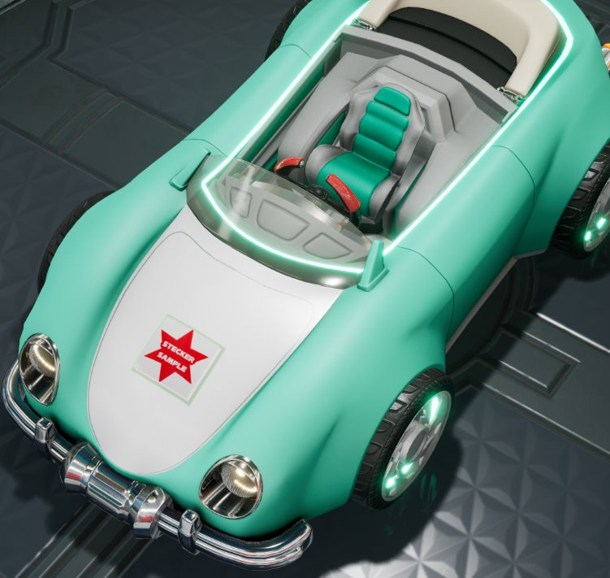



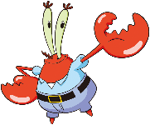

Reward: Vehicle Decals
Players can decorate their freely customized vehicles using decals, which can be placed on the front or rear parts, expanded or shrunk, and rotated. Each has a transparent outline so that decals cannot be connected or overlapped.
 | Image | Stamp | Source File
1 |  | SpongeBob Sticker 1 | SB_SBob_039_REV.png
2 |  | SpongeBob Sticker 2 | SB_Pat_142_alt.png
3 |  | SpongeBob Sticker 3 | SB_Squid_008_REV.png
4 |  | SpongeBob Sticker 4 | SB_Classic_Sandy_004_REV2.png
5 |  | SpongeBob Sticker 5 | SB_SUP_KK_MrK_003.png
6 |  | SpongeBob Sticker 6 | SB_Pktn_036_REV.png
Example of how it may look in-game
Development in progress; in-game captures will be submitted at a later date

Slide 5
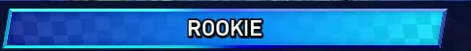





Reward: Title Plates
Players can set title plates to show off on their profile or during loading screens for online mode.
Example of how it may look in-game
 | Image | Source File
1 |  | SB.Jfish.001.spot.png SB.Jfish.002.spot.png SB.Squid.012.spot.png SB_Grp_166b_Alt.png SB_GTG_SS21_YS_Grp_003.png SB_Icon_259b_spot.png SB_Jfish_003_REV.png SB_Jfish_004_REV.png SB_Pat_008_Alt.png SB_Pat_143_REV_1.png SB_Pat_143_REV_2.png SB_Prop_105_spot_1.png SB_Prop_105_spot_2.png SB_SBob_338_REV2.png SB_SBob_TruthSquare_005.png SB_SS14_GP_SBob_003_REV.png SB_SS14_GP_SBob_004.png
２

Slide 6
Reward: Title Plates
These are rewards from collaboration events – or officially, ‘Festival’ events. Titles and plates (text) are treated as a set, and we plan to have the following variations. Rewards are based on points earned or the number of winning streaks during the event, and titles will be unique to SpongeBob. Please review the following ideas, and if you have other suggestions, we would love to hear them.
 | Reward
Title for ranking 1-10
Title for ranking 11-100
Title for ranking 101-1000
Title for participating
Based on event points
2 winning streaks
3 winning streaks
SpongeBob Festival TOP10
SpongeBob Festival TOP100
Here are some other ideas that came up within the team, in case you prefer these:
・SquarePants Master
・King Krabby Patty
・Aye aye, captain!
・A few moments later moments later
or perhaps a reference to SpongeBob timecards with a Sonic Racing twist:
・Several races Later...
・Meanwhile in Bikini Bottom
・Many races later...
・Three wins later...
・Three wins in a row later...
*Text font and colour is tentative.
SpongeBob Festival TOP1000
SpongeBob Festival
Residents of Bikini Bottom
Legendary Fry Cook
*Generic Plate + Collab Text
Legendary Fry Cook

Slide 7
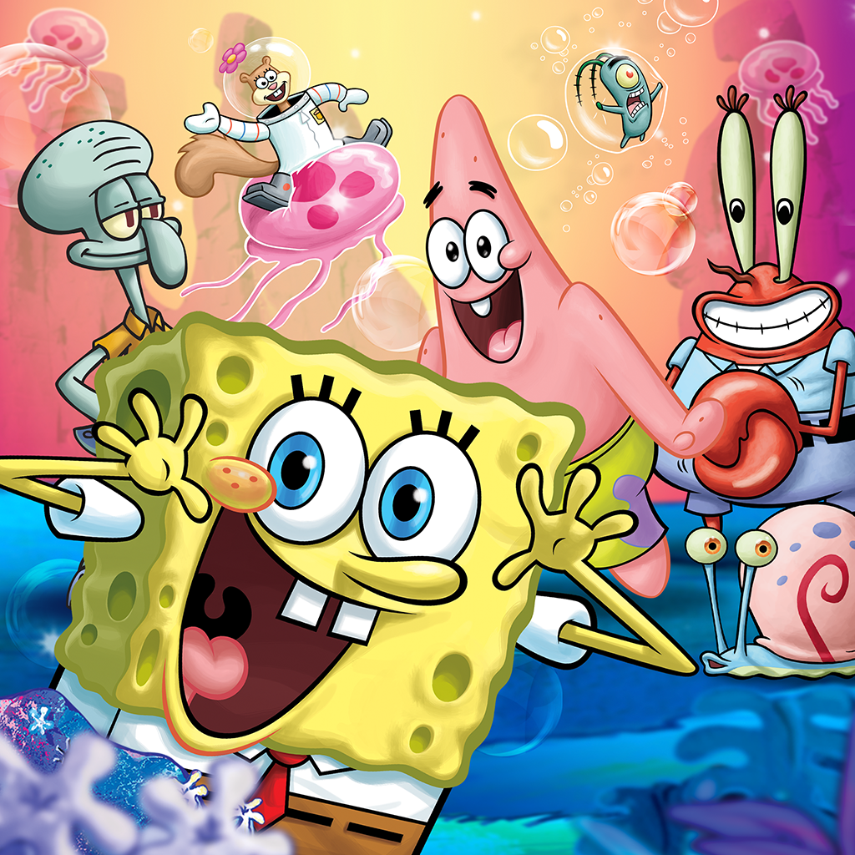

Jukebox: Jacket Art
Image to be used in the jukebox mode, where players can listen to tracks from the SpongeBob course.
 | Image | Asset | Source File
1 |  | Collab Jacket SpongeBob | SB_RT_Asia_KA_002.png

Slide 8

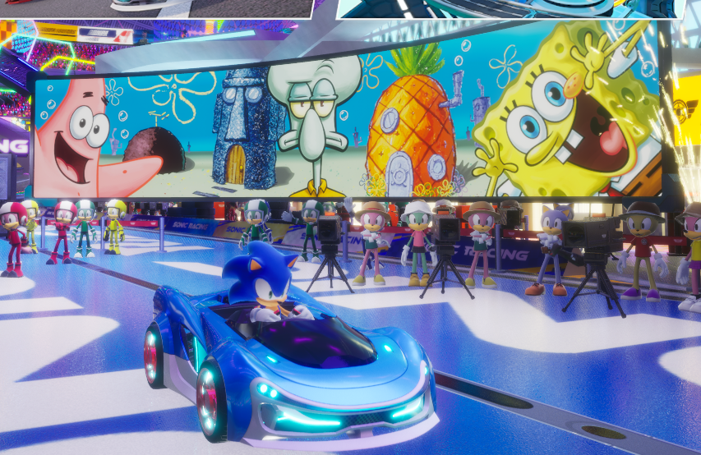

Festival: Event Monitor
This is a monitor that appears in the background of the main menu during Festival events.
Example of how it may look in-game
Image used
Image | Source File
 | SB_BG_001.png SB_ES_Squid_002_EA_REV.png SB_Pat_142_alt_EA.png SBX_SBob_479_REV1_EA.png

Slide 9
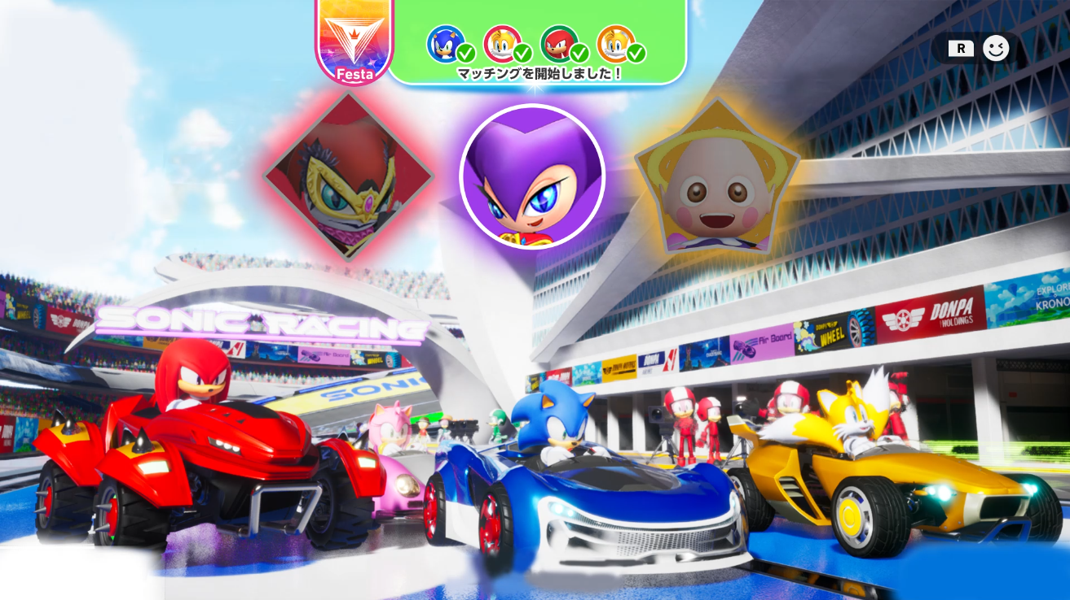

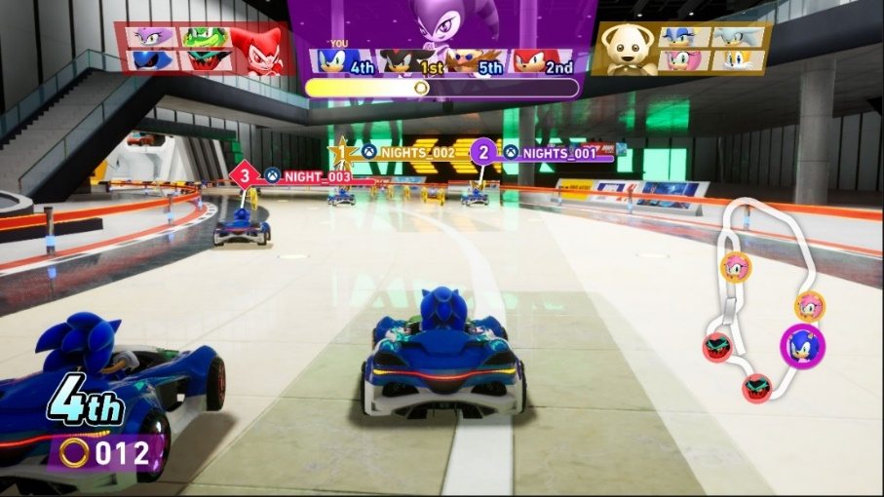


Festival: Team Icons
These are icons for when players team up during Festival events.
Example from NiGHTS collab
 | Image | Asset | Source File
1 |  | Team SpongeBob Icon Background Colour: Yellow | SBX_SBob_479_REV1_EA.png
2 |  | Team Patrick Icon Background Colour: Pink | SB_Pat_142_alt_EA.png
3 |  | Team Squidward Icon Background Colour: Blue/Purple | SB_ES_Squid_002_EA_REV.png

Slide 10
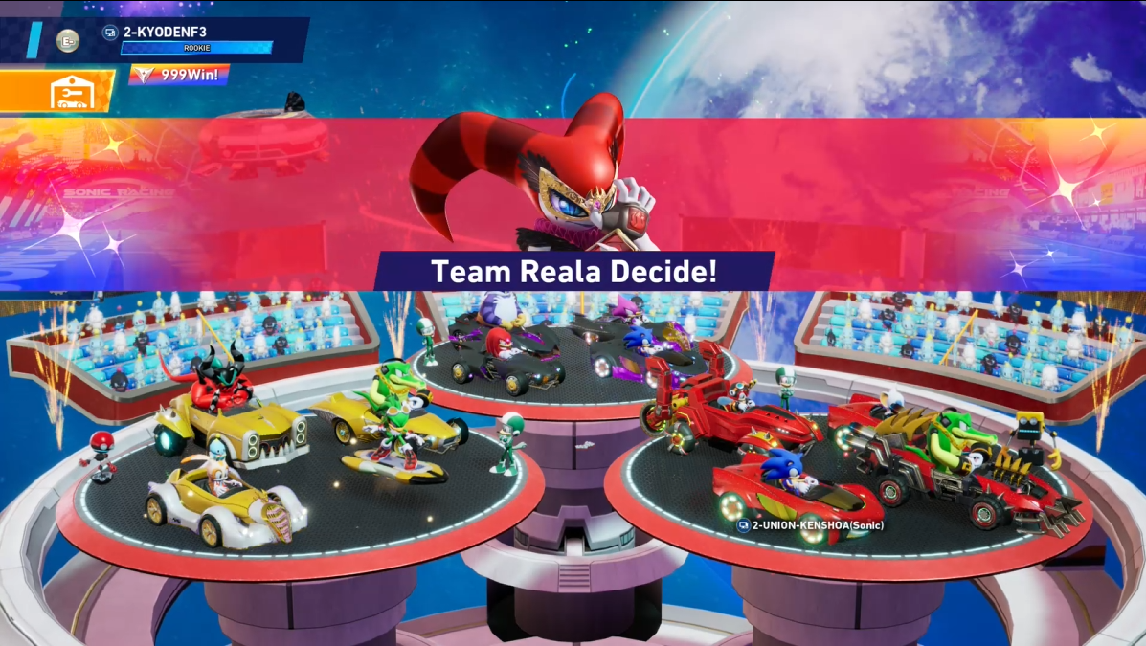
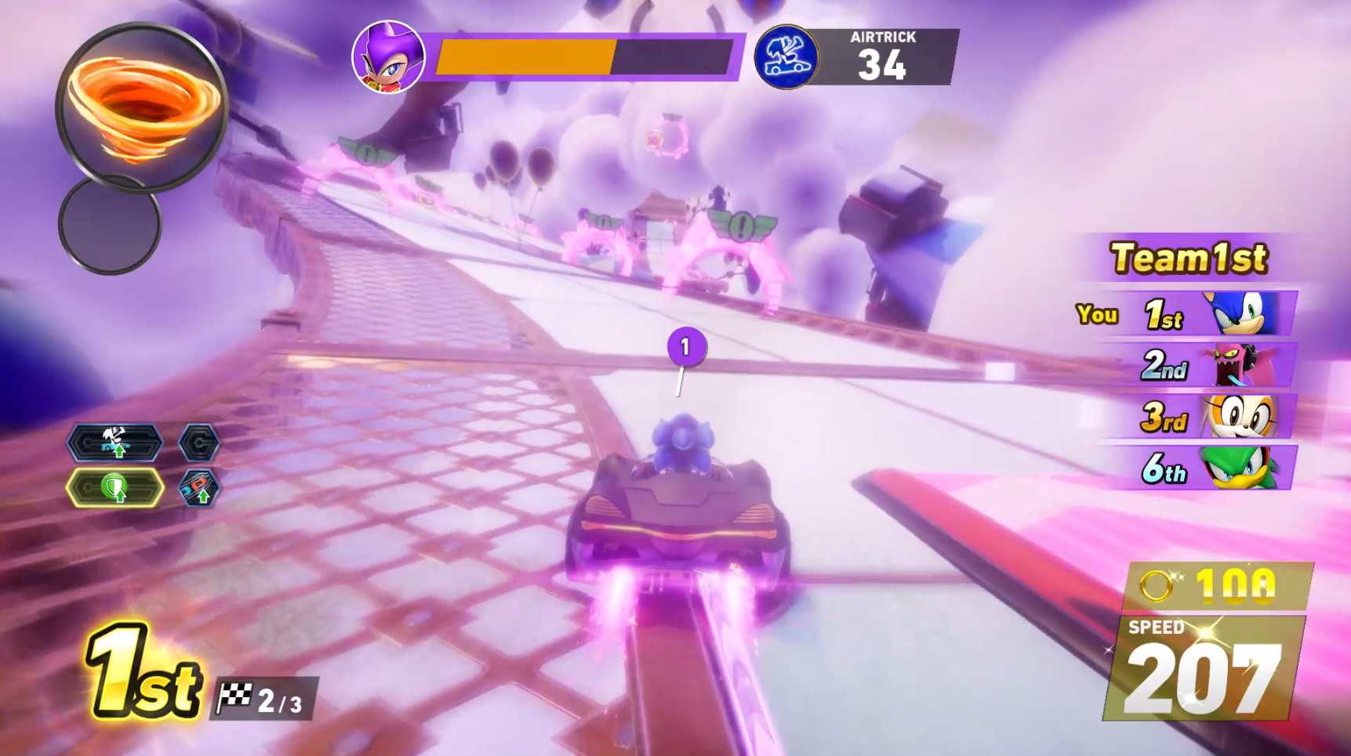
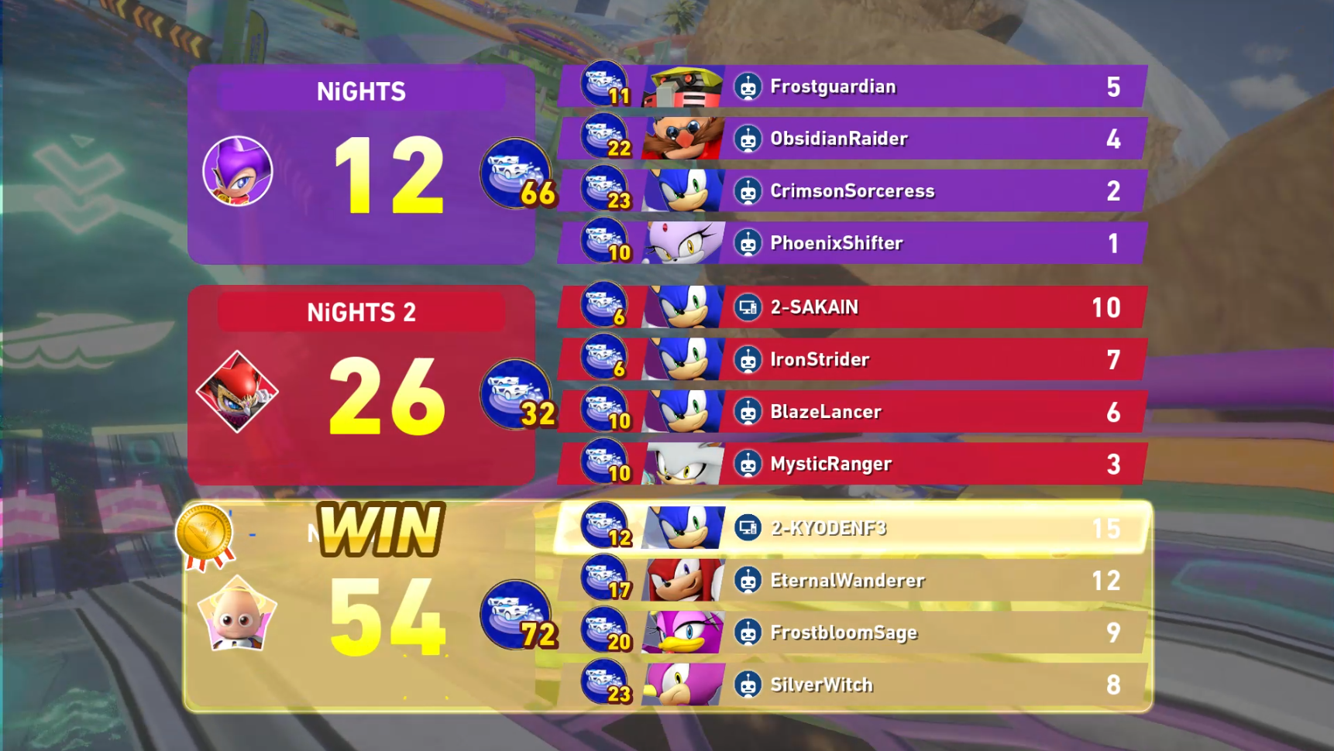
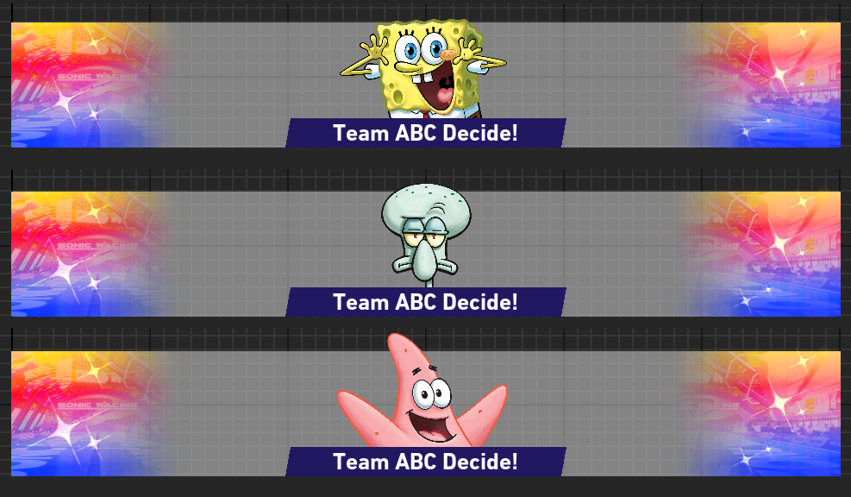
Festival: Team Icons
Attaching examples from our NiGHTS Festival collaboration for reference.
Players divide into 3 teams and compete for the most points during these limited-time events.
Example from NiGHTS collab
◀SpongeBob cut-ins for when teams are decided.

Slide 11
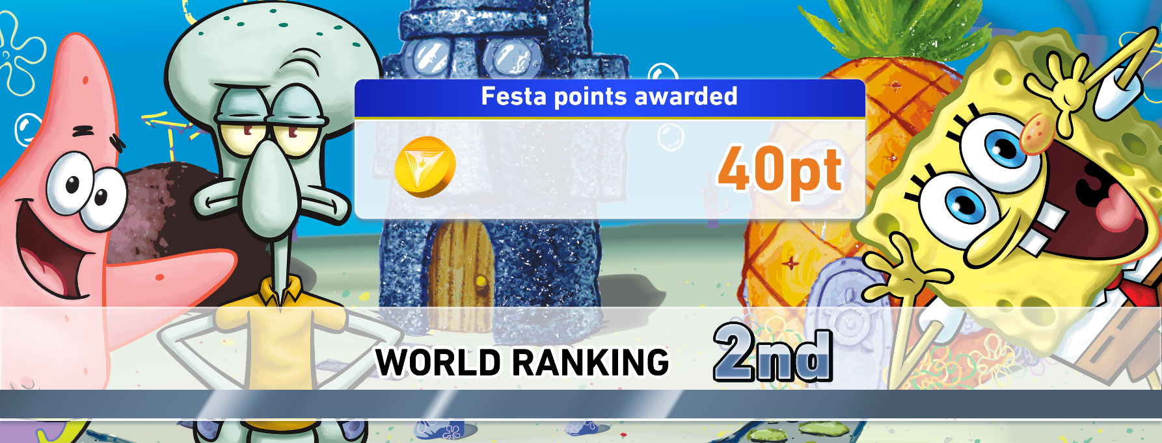
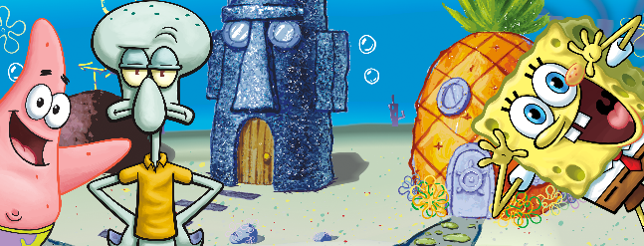
Festival: End of Event Notice
This is the notice that displays when the Festival event ends.
It will show the player’s world ranking and number of points they earned.
▲With UI
Image | Source File
 | SB_BG_001.png SB_ES_Squid_002_EA_REV.png SB_Pat_142_alt_EA.png SBX_SBob_479_REV1_EA.png

