Slide 1


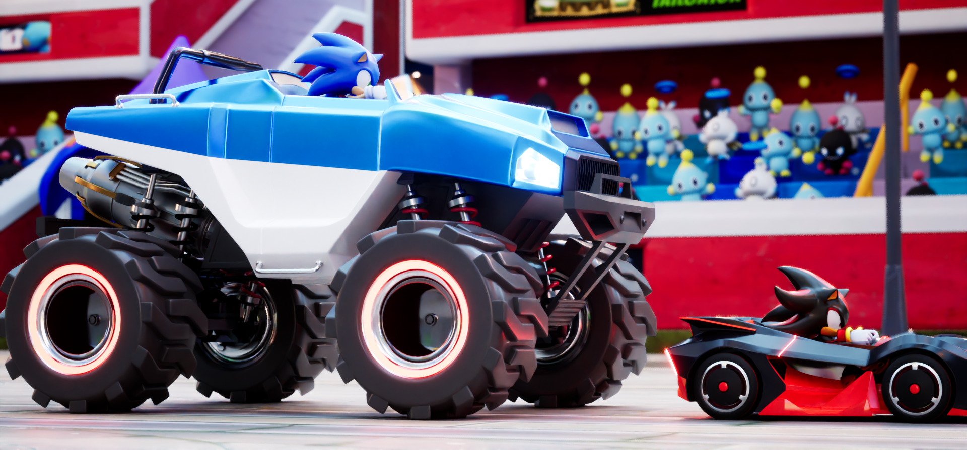
TERRA
Avatar Course Update
20241112

Slide 2
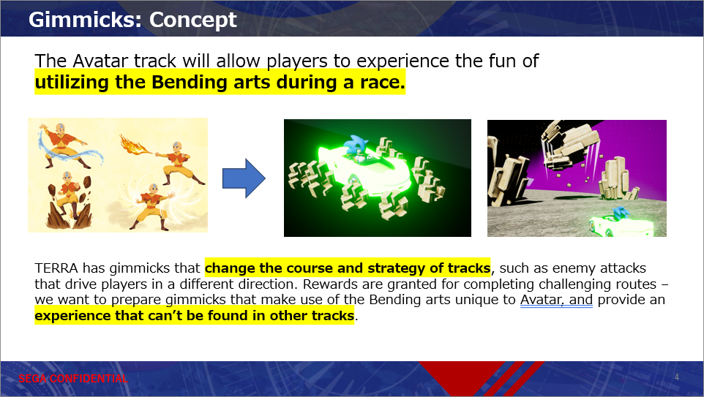
Preface
Regarding the previously shared course concept below,
some challenges came up as development progressed.
This document will outline an alternative proposal.

Slide 3
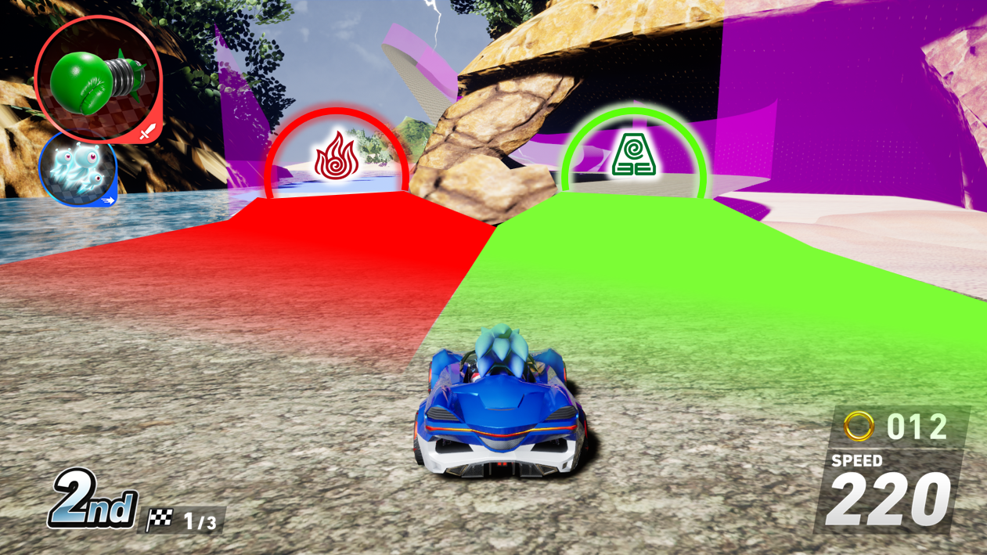
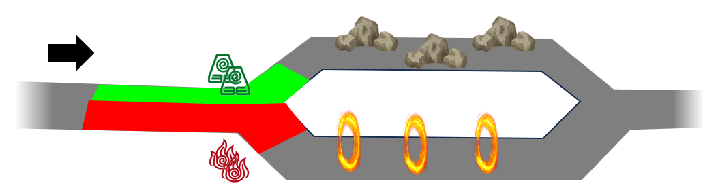
Gameplay Direction for Avatar Course
When players choose their bending route and go through the branch-off area,
they will now have more of a passive role to enjoy the gimmicks.
Airtricks off the rocks!
Superdash through the fire rings!
Previously, players would obtain bending abilities and use them throughout the course; however, this idea clashes with the base Sonic Racing gameplay of using items, and leads to the concern that players could complete a lap without making use of any mechanics as it isn’t intuitive enough for a fast-paced racing game. The goal is to mitigate this risk by integrating gimmicks into the course itself.

Slide 4
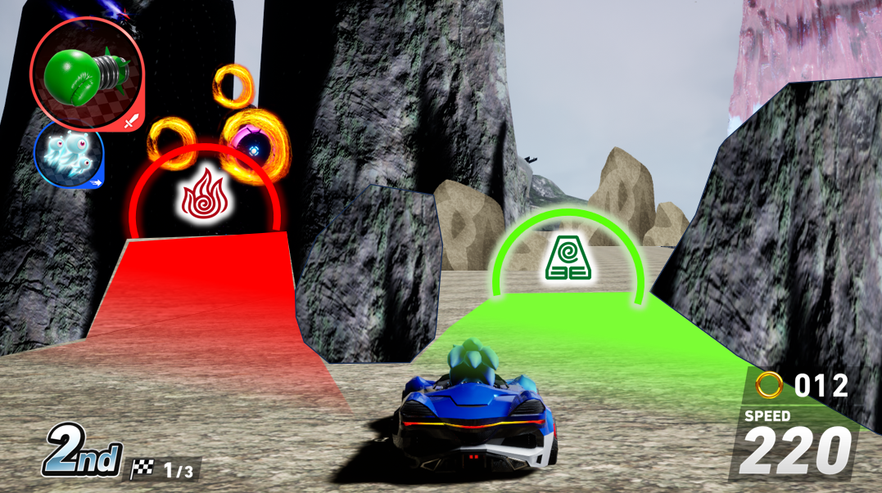
Avatar Course Layout
There will be one branch-off area each in the Lion Turtle Islands and Air Nomads.
Players can choose the same bending route as before, or a different one that looked more fun for them.
*Bending routes will change at random, e.g. to Air Bending & Water Bending
*No layout changes have been made aside from these bending routes

