Slide 1


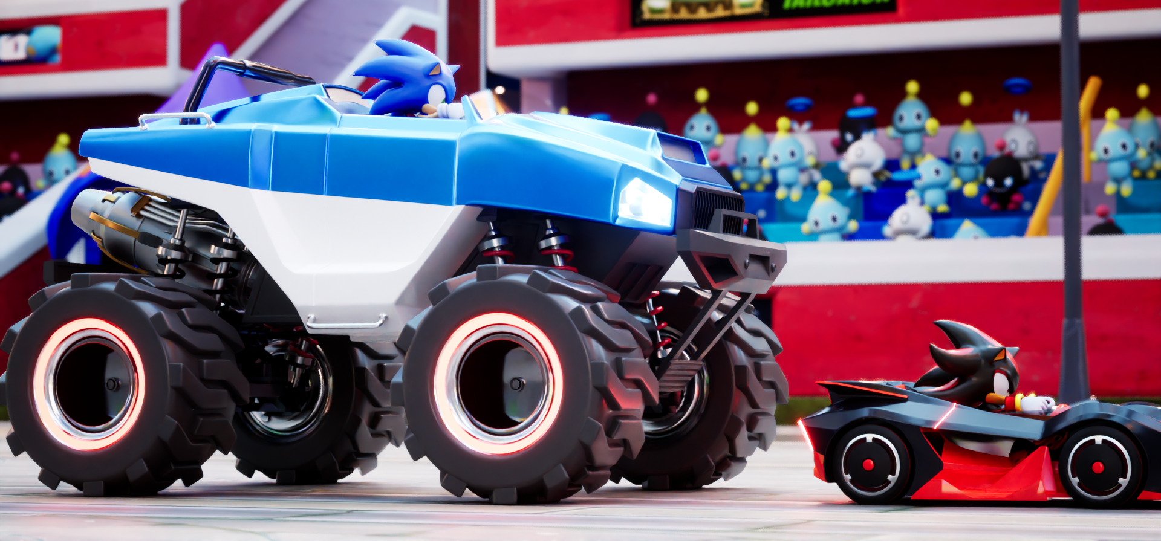
TERRA
Avatar Track

Slide 2
Introduction
Points of discussion
・Part 1: Confirm structure and gameplay of track
    Gimmicks
    Track Layout
・Part 2: Regarding Art
    We will share visions under consideration
    Questions
    Additional assets we would like you to provide

Slide 3
Structure and Gameplay of Track

Slide 4
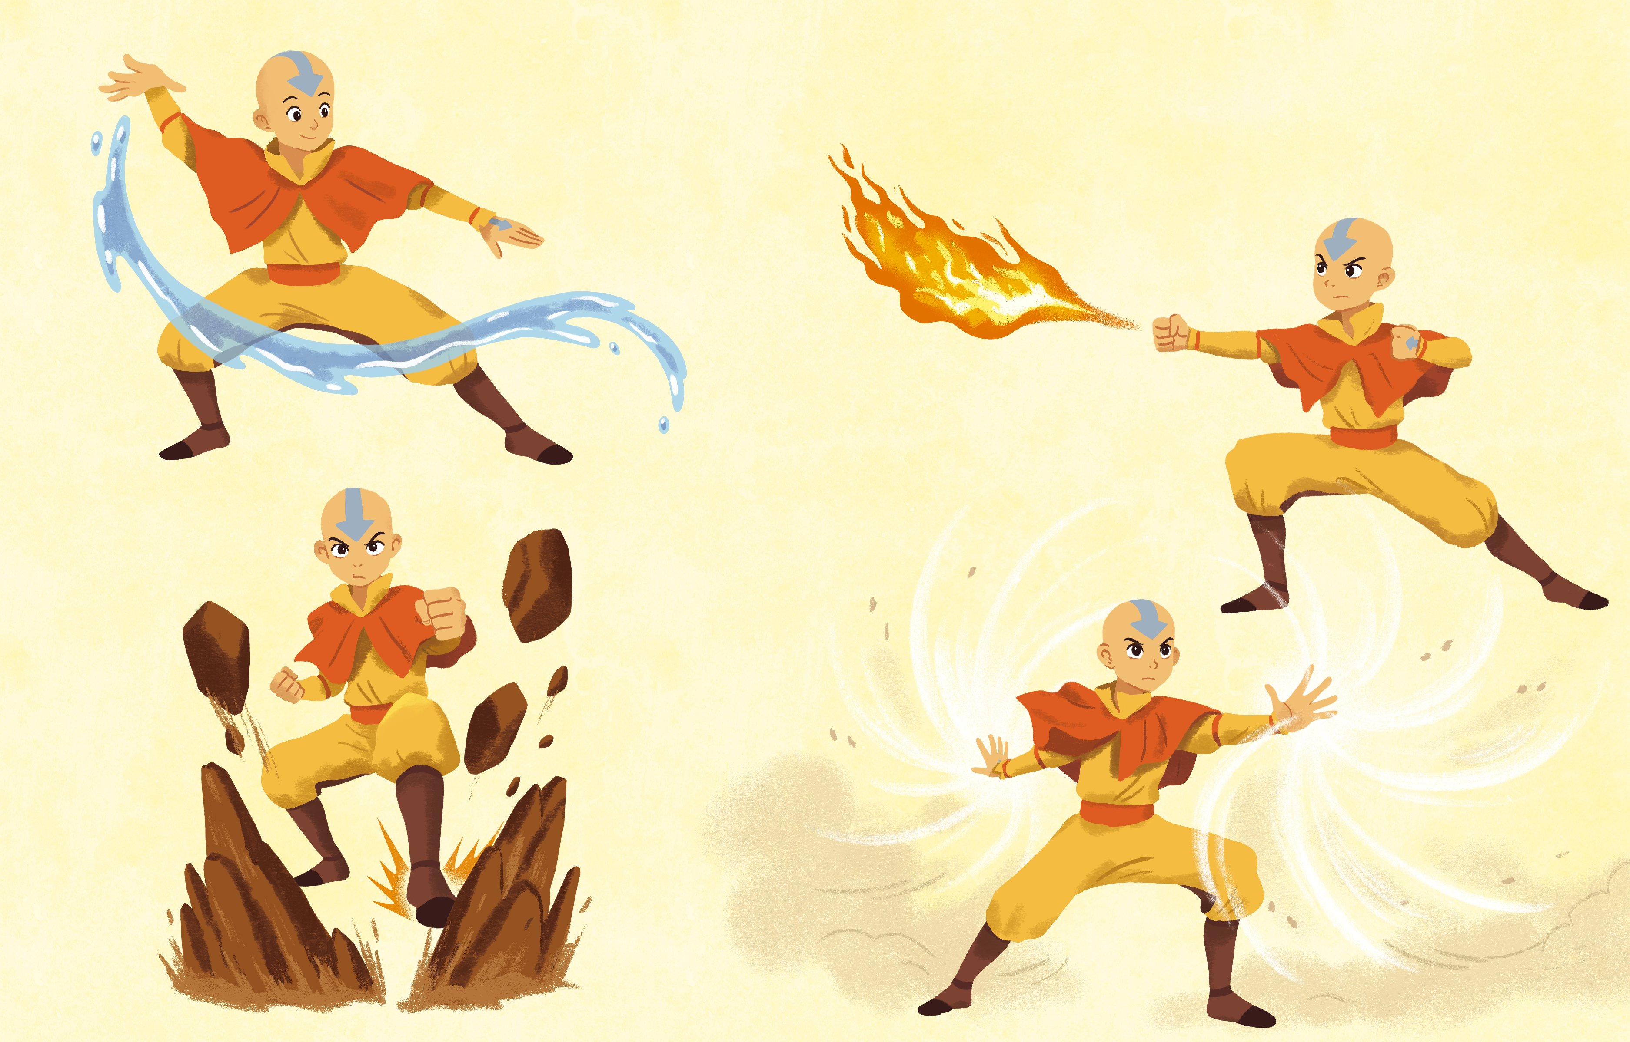
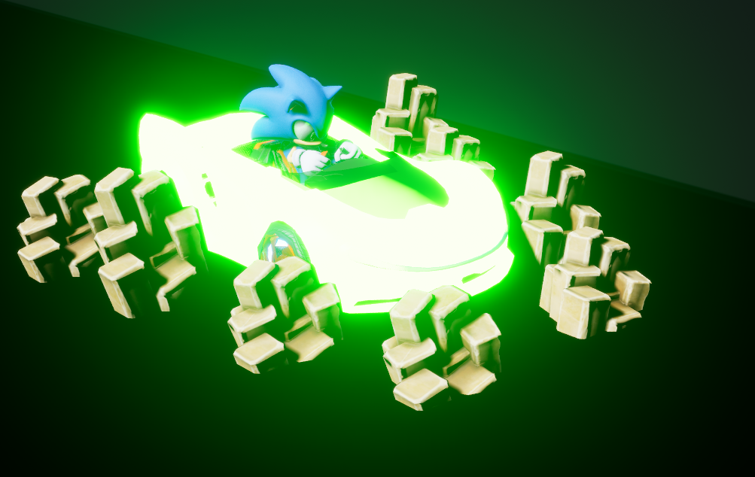
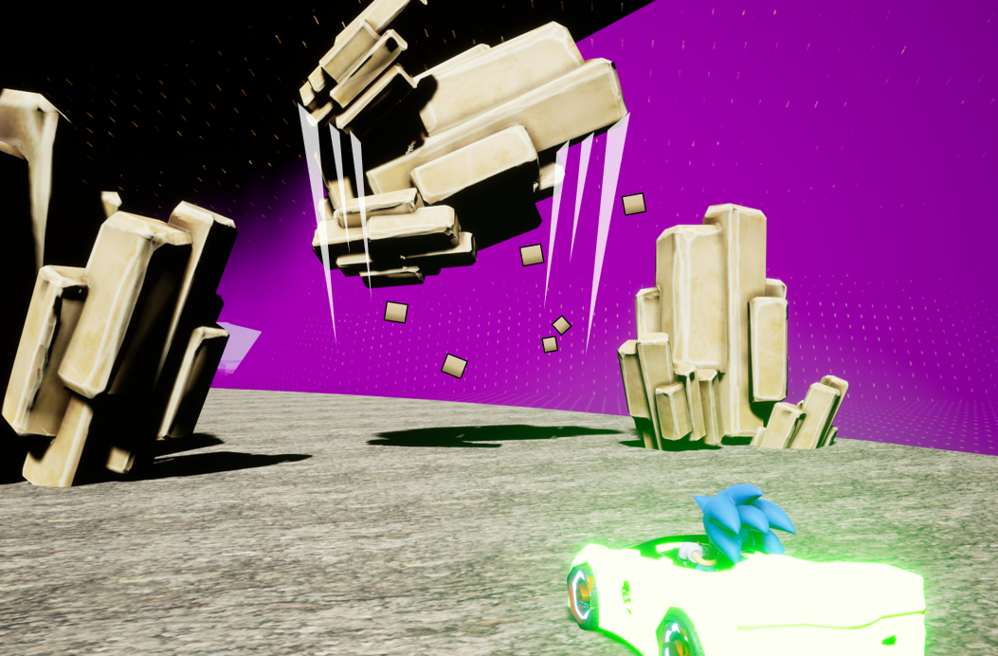
Gimmicks: Concept
The Avatar track will allow players to experience the fun of utilizing the Bending arts during a race.
TERRA has gimmicks that change the course and strategy of tracks, such as enemy attacks that drive players in a different direction. Rewards are granted for completing challenging routes – we want to prepare gimmicks that make use of the Bending arts unique to Avatar, and provide an experience that can’t be found in other tracks.

Slide 5
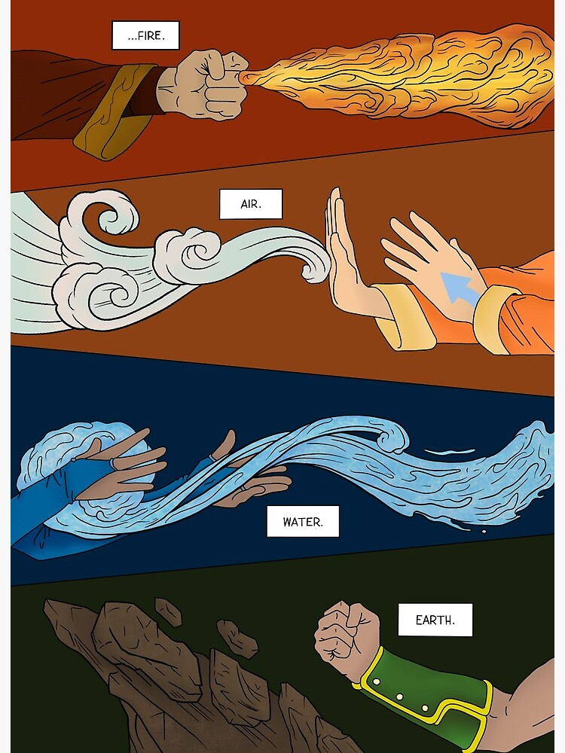
Gimmicks: Flow of Gameplay
Bending acquired during the Lion Turtle Islands area; tutorial on how to use them.
Multiple gimmicks at the Southern Air Temple; players choose the best route for their acquired power.

Slide 6
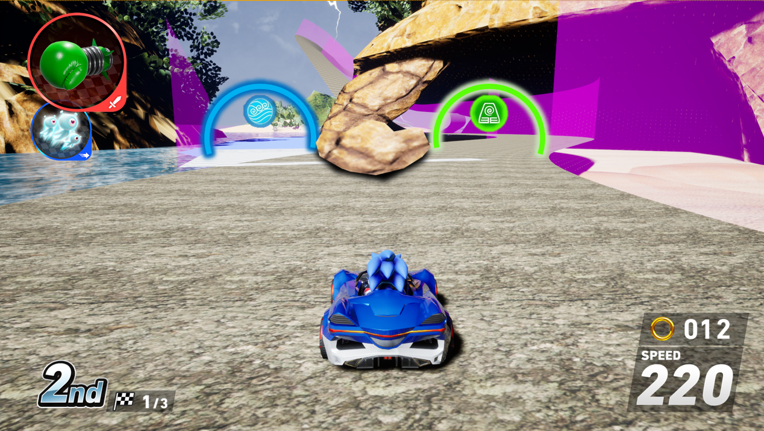
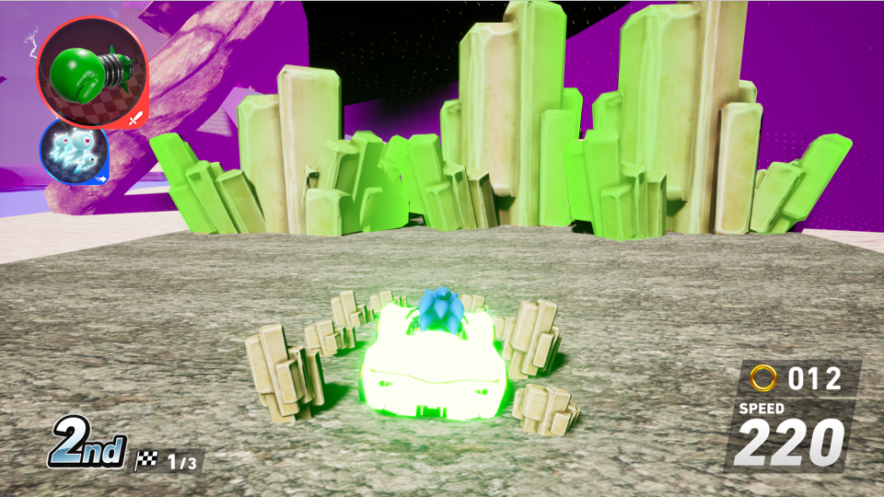
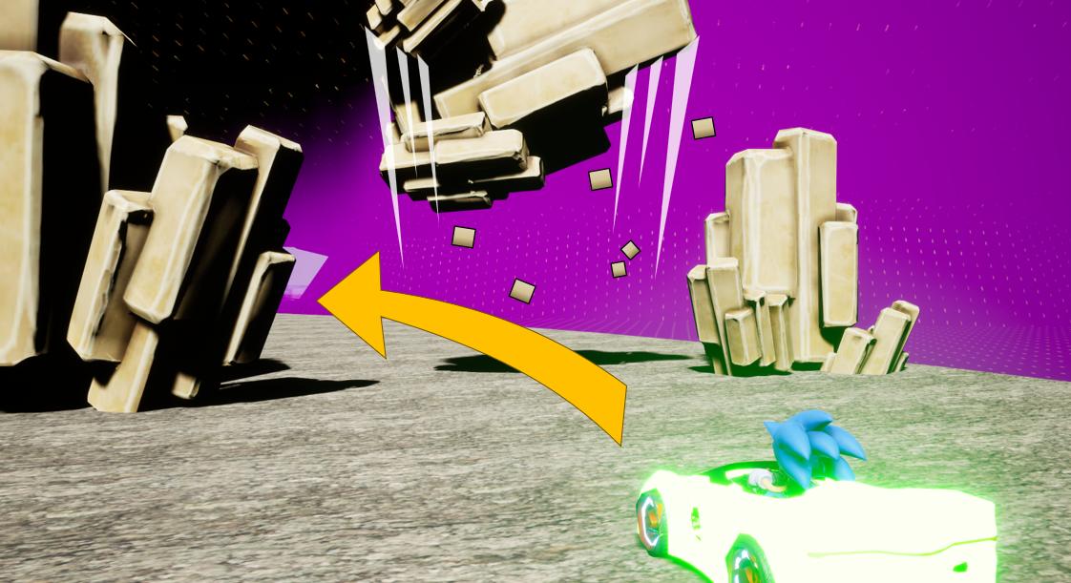
Acquire Bending Powers
Bending powers are acquired by passing through Bending Gates, which will give players the ability to control and clear gimmicks throughout the track.
Choose Earthbending
Get Earthbending power
Make the rocks float and go through the shortcut!
*Abilities are reset in the second lap (during CrossWorlds), and are acquired again by choosing a power during the final lap.
*The vehicle effect is tentative; we may make it flash, not constantly glow as shown.
Notes:
オンラインは村田さん、中村さんに確認必要
見た目を変えるならアプリ班（山田さん）に確認必要

Slide 7
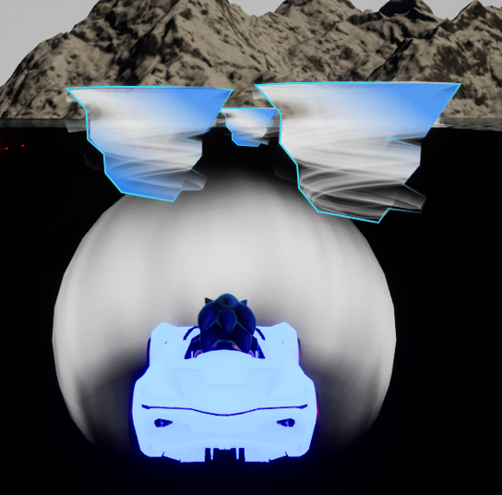
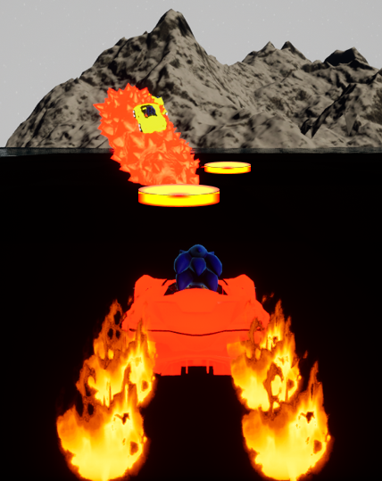
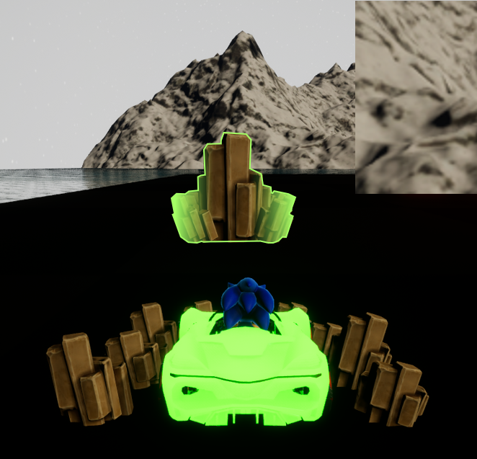
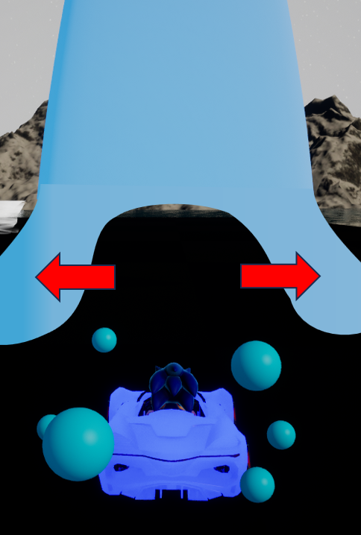

Examples of Bending Powers
Ideas currently being considered:
■Air Bending Gate
Use tornadoes to jump
■Fire Bending Gate
Obtain better items by melting ice
■Earth Bending Gate
Make rocks float and move them out of the way
■Water Bending Gate
Avoid water obstacles
Notes:
攻撃は他のアイテムとの干渉も出てくるので対応重くなりそう

Slide 8
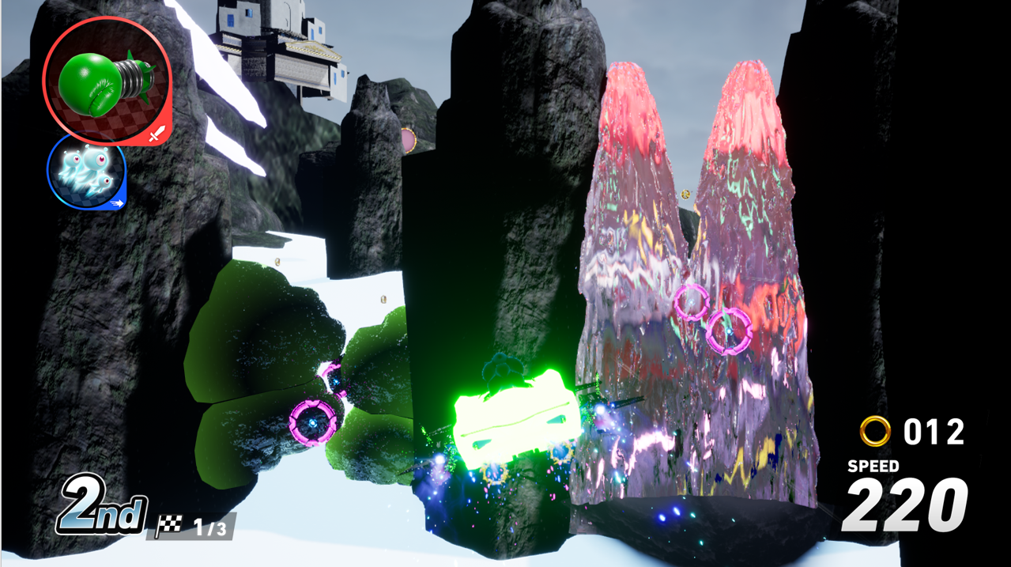
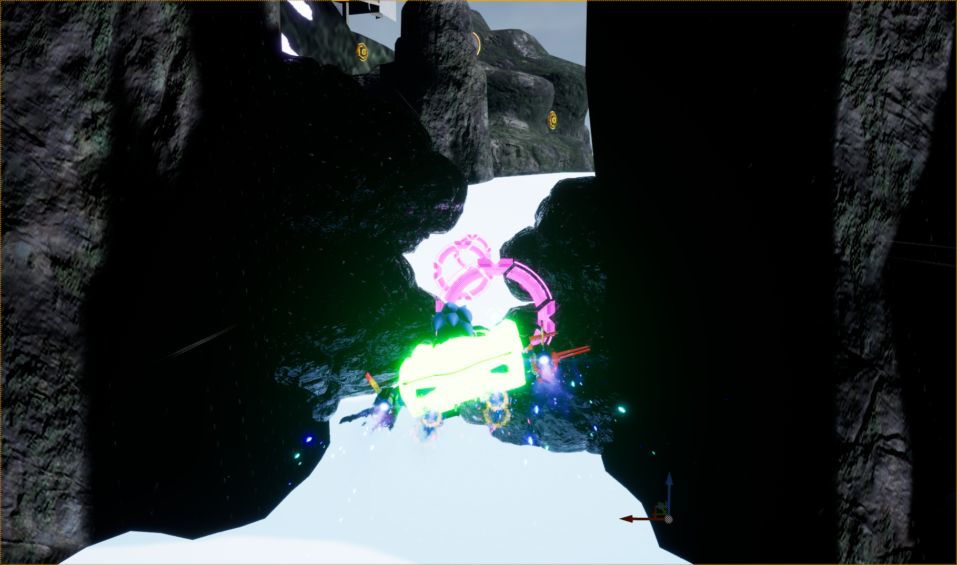
Change in Direction
Choose advantageous routes according to the player’s acquired Bending power.
Route with boulders and waterfall – go the boulders route to make use of the Earthbending powers!
Can only be passed by players who chose Earthbending!
Above is a very simple example, but we will have more gimmicks that provide multiple options even if there are players who choose the same Bending power.

Slide 9
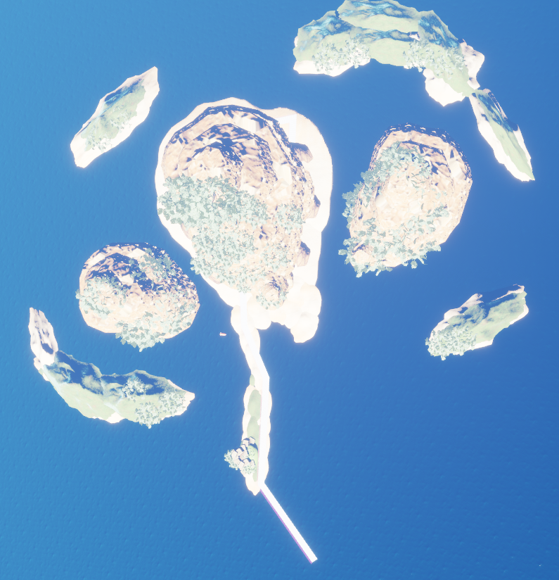
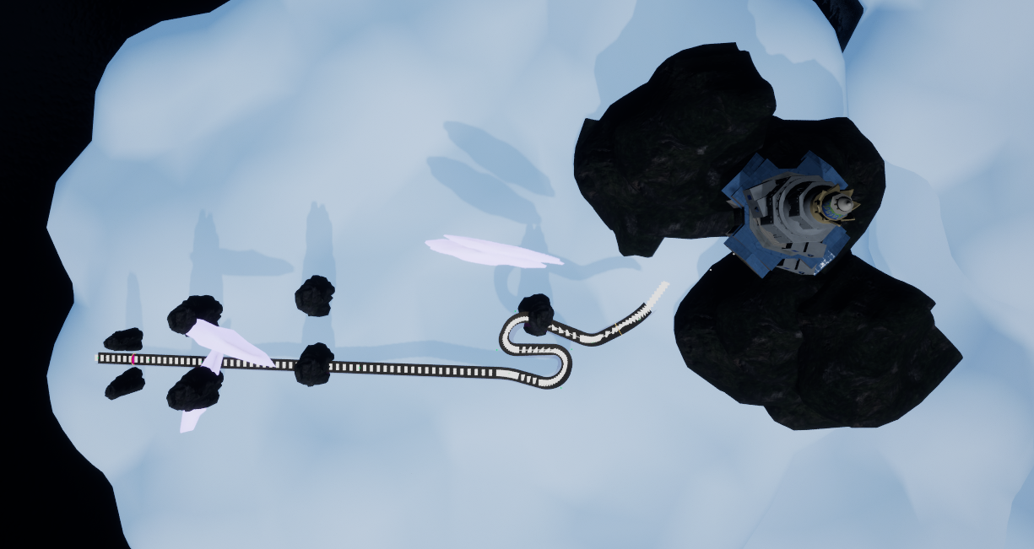
Track Layout
The current plan is a layout starting in the Lion Turtle Islands, then warping to the Southern Air Temple, then warping back to the starting area.
For reference only; we will adjust fine details at a later date.

Slide 10
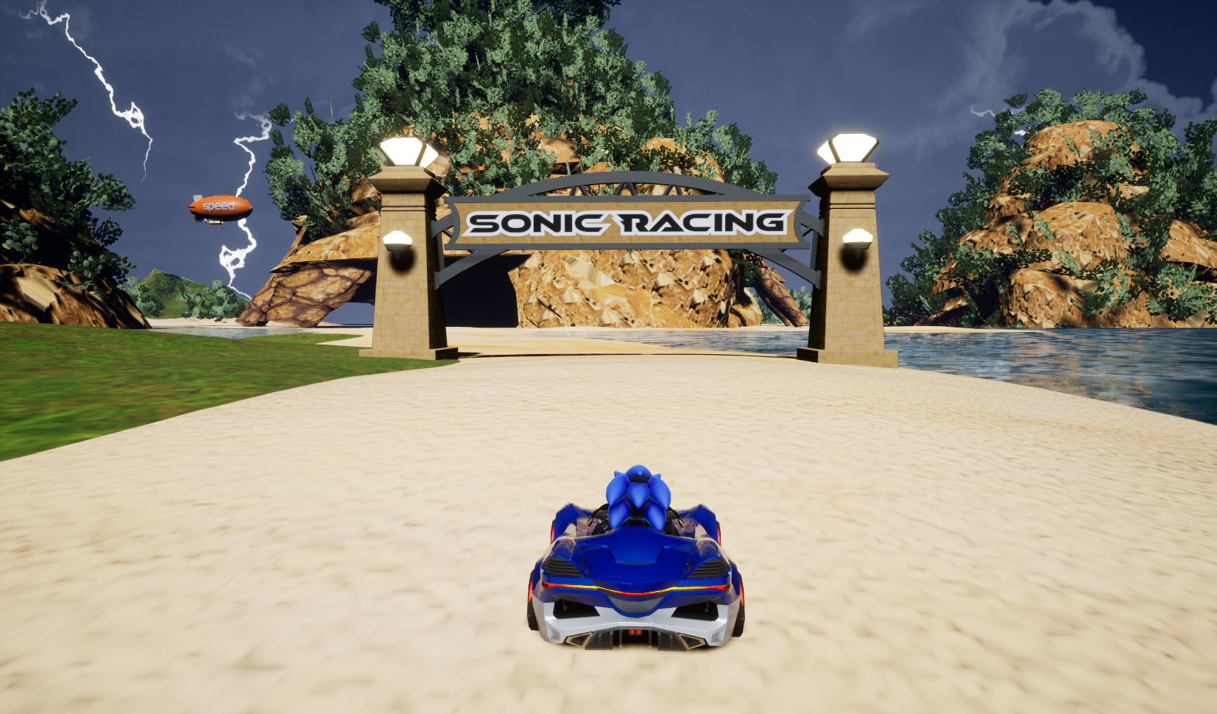
Track’s Flow (1 of 4)
■Start/Goal
The race will start and end on a beach in front of the Lion Turtle Islands.
■Bending Gate
Players choose which Bending ability they want in this lap.
They can reobtain it during the final lap.
2 Bending types are provided at random for each race.

Slide 11
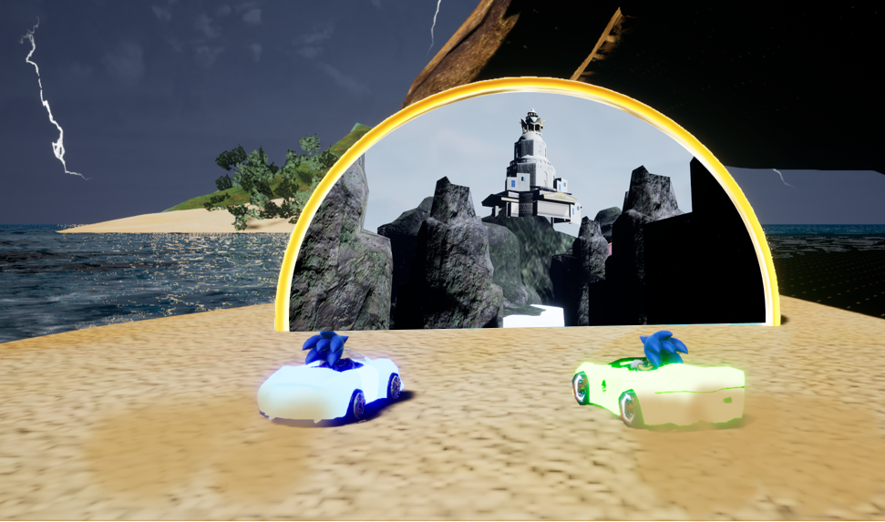
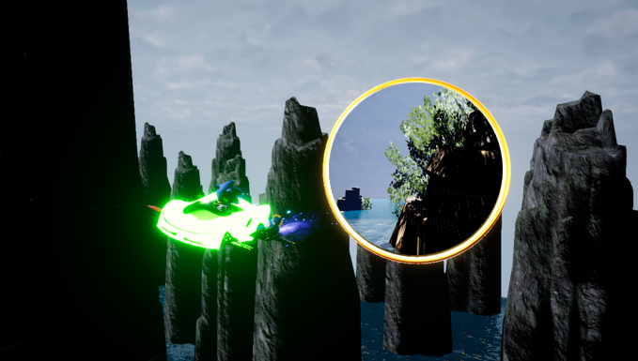
Track’s Flow (2 of 4)
■Bending Tutorial
Objects are placed all around the track after passing through the Bending Gate, letting players test and experience what effects their Bending powers are capable of.
■Warp to Air Nomads
TERRA has a warping gimmick called Ring Gates, which we plan to use in transporting the player from Lion Turtle Islands to Air Nomads. We are also considering changing the design to match the aesthetics of Avatar.

Slide 12
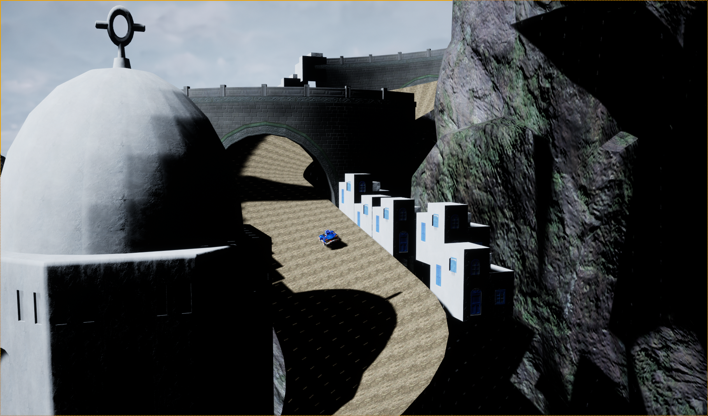
Track’s Flow (3 of 4)
■Various Bending Areas
Between arriving in Air Nomads and up to the Southern Air Temple, multiple gimmicks will appear and there will be an area where players use their Bending ability to come up with a strategy for the track.
Additionally, these gimmicks will be random for each race, depending on what Bending Gates appear during the Lion Turtle Islands phase.
(e.g. If there is a Fire Bending Gate, objects related to fire will be allocated)
■Town Area
Players will drive through the town at the foot of Southern Air Temple.
Compared to the first half of the track with generous curves, this area will have more challenging sections with hairpin turns.

Slide 13
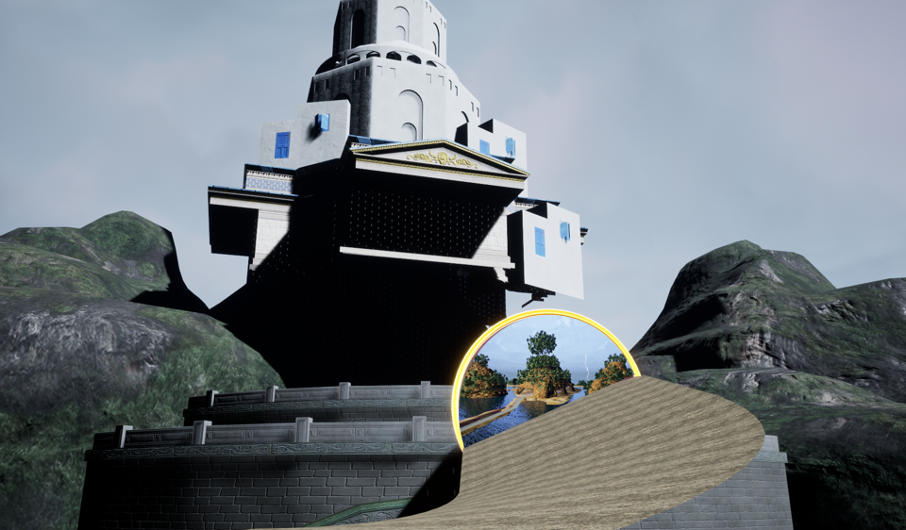
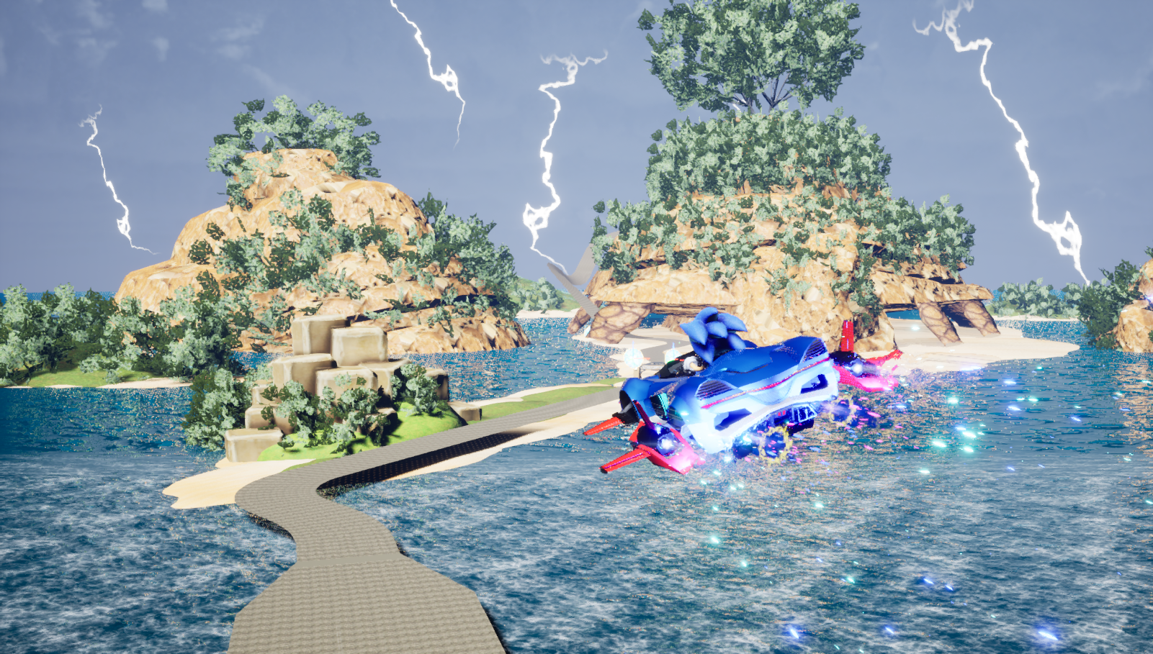
Track’s Flow (4 of 4)
■Warp back to Lion Turtle Islands
When the Southern Air Temple is reached, a Ring Gate will appear and players are returned to the starting point – Lion Turtle Islands.
■End of First Lap
The first lap ends when players return through the Ring Gate from Southern Air Temple, placing them in the sky and showing a view of the Lion Turtle Islands.

Slide 14
Regarding Art

Slide 15
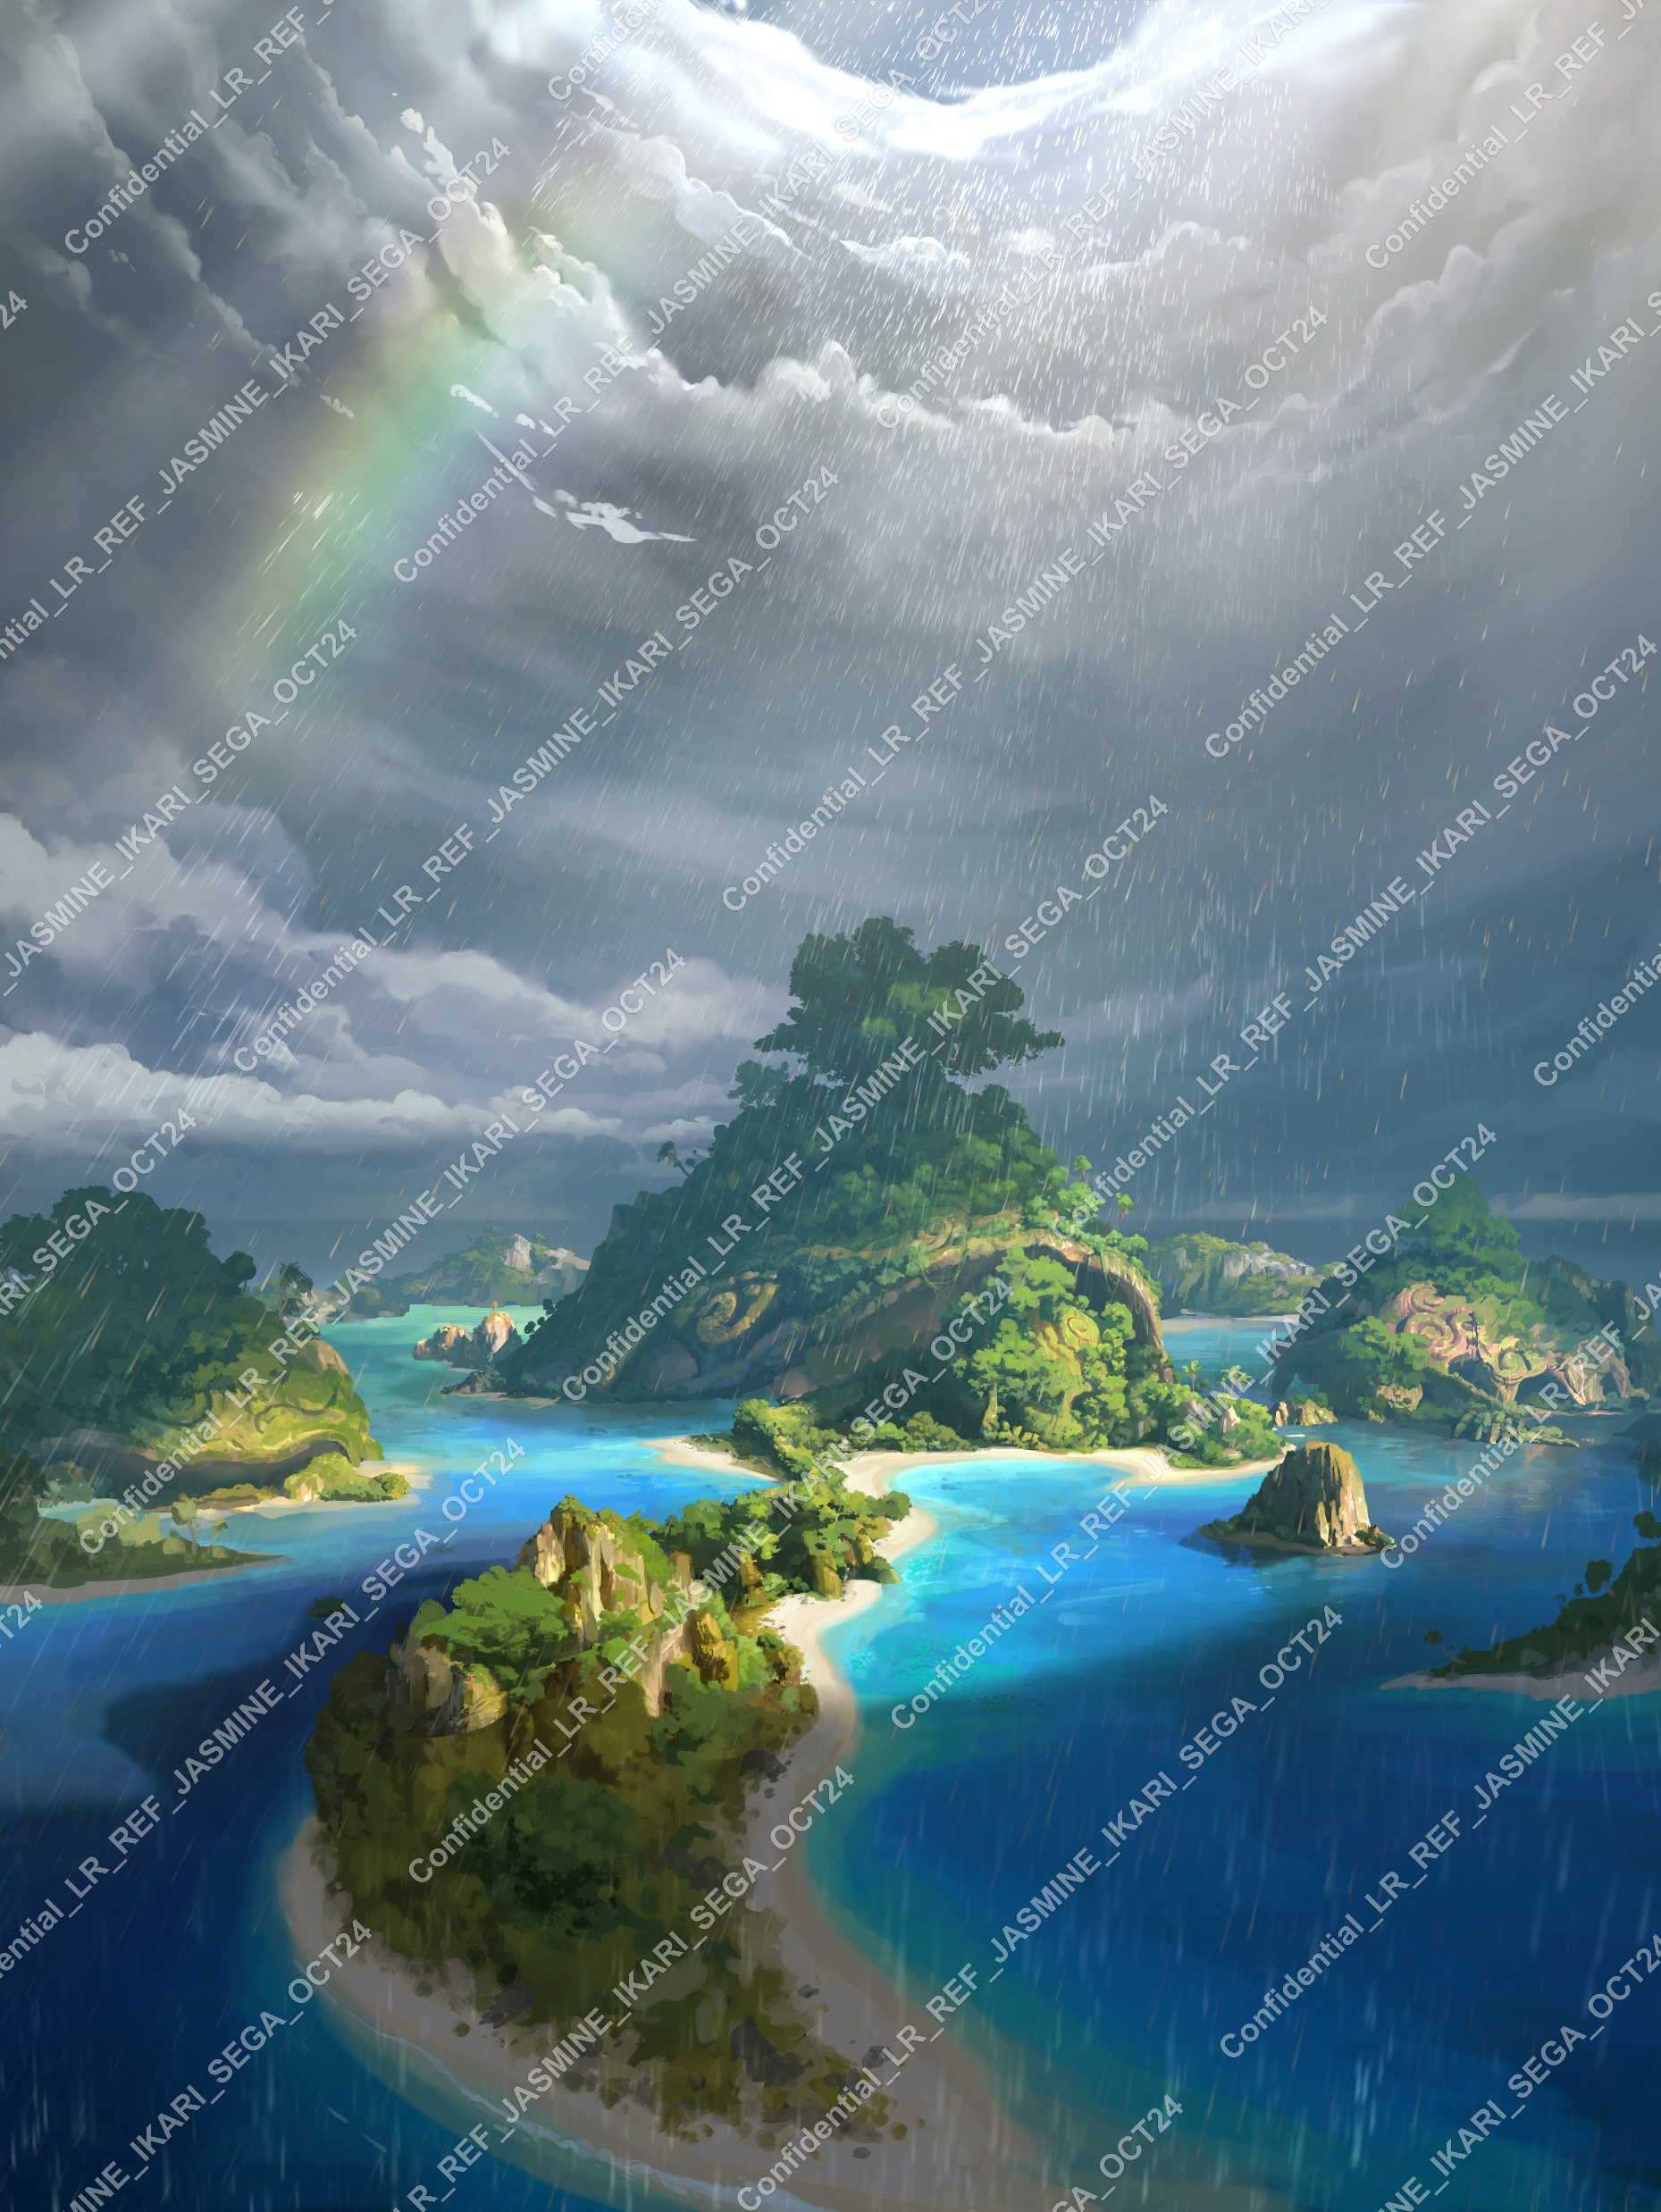
Art Vision
Lion Turtle Islands
Time of day to be set around noon.
Weather to be cloudy/rainy with sun shining through above the island.

Slide 16
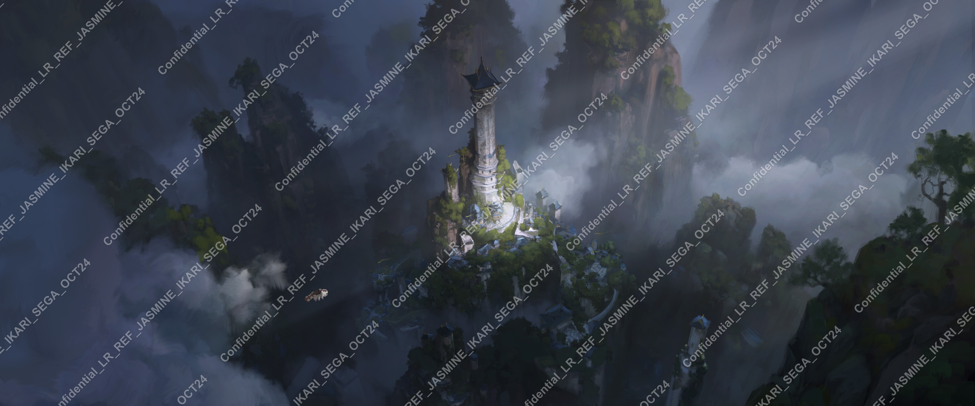
Art Vision
Southern Air Temple
Time of day to be set around noon to match Lion Turtle Islands.
Weather to match concept art, with a dark, cloudy feel and some sun on the town.

Slide 17
Questions
Please confirm the following points (approaches) in order to make the game design ‘work’ as a racing game.
General
May we add banks and/or fences to make the track boundaries obvious?
May we adjust size and placement of objects and scenery (including Lion Turtle Islands) to fit within the camera view?
Lion Turtle Islands
May we create new paths like wooden bridges and other structures in addition to the original landscapes?
The intention is to build routes with good balance in gameplay and richness in strategies.
Is it okay to place a Ring Gate around the turtle's stomach and warp players to the Southern Air Temple?
Southern Air Temple
May we widen the paths between buildings to make it racetrack-friendly?
May we create aerial routes using suspension bridges and stone blocks around the Air Nomads town?
We want players to experience the various driving modes (not just land but also air/water) and provide the best balance for a racing game.

Slide 18
Request for Additional Assets
The following assets would help us tremendously in production:
Lion Turtle Islands
Documents that show detailed patterns of the three ‘lion turtles’ and internal designs/structure of their bodies
3 views or 3D images and settings of plants (trees, grass, etc.)
Southern Air Temple
3 view or 3D images showing details of plants and buildings
3D model of the Sky Bison
Gimmicks
・Concepts, settings, images (screenshots) showing Bending effects from the movie

Slide 19
Appendix

Slide 20
Appendix
■Basic Track Rules
Players must complete laps around the track.
Each lap is around 60 seconds, give or take.
Players must return to the starting area at the end of each lap.
Starting areas are always on land (not air or water).

Slide 21
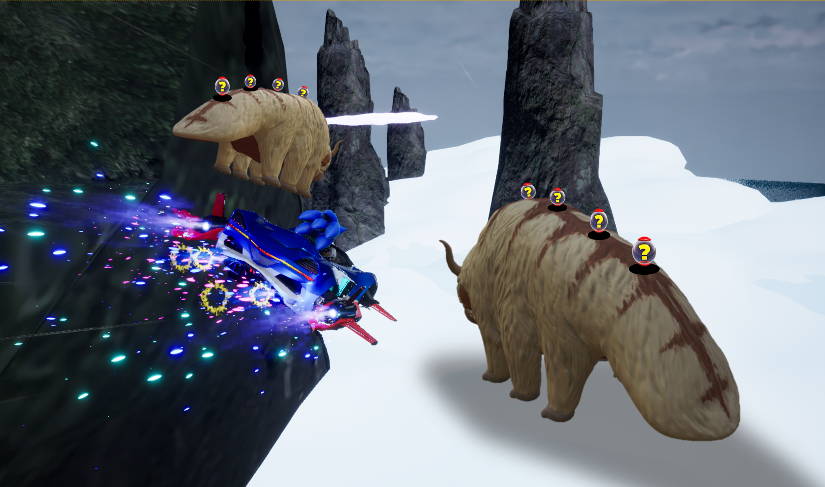
Appendix
If you are able to provide model data for the Sky Bison, we would like to implement the following gameplay:
The Sky Bison would “carry” helpful items and rings on its back, being positioned as an assisting character (and not one to attack players).

